Slide 1
Chapter 3 Kinematics in Two Dimensions; Vectors

Slide 2
Contents of Chapter 3
Vectors and Scalars
Addition of Vectors—Graphical Methods
Subtraction of Vectors, and Multiplication of a Vector by a Scalar
Adding Vectors by Components
Projectile Motion
Solving Projectile Motion Problems
Projectile Motion Is Parabolic
Relative Velocity

Slide 3
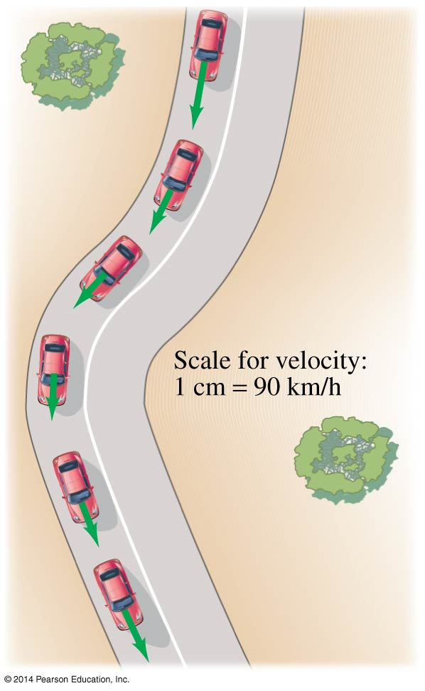
3-1 Vectors and Scalars
A vector has magnitude as well as direction.
Some vector quantities: displacement, velocity, force, momentum
A scalar has only a magnitude.
Some scalar quantities: mass, time, temperature

Slide 4
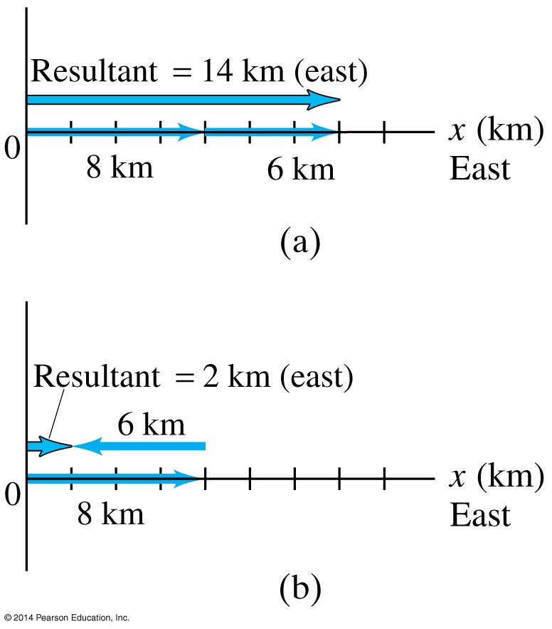
3-2 Addition of Vectors—Graphical Methods
For vectors in one dimension, simple addition and subtraction are all that is needed.
You do need to be careful about the signs, as the figure indicates.

Slide 5
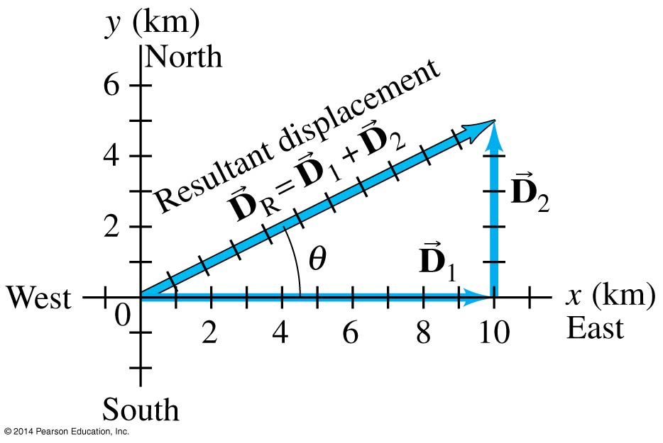
3-2 Addition of Vectors—Graphical Methods
If the motion is in two dimensions, the situation is somewhat more complicated.
Here, the actual travel paths are at right angles to one another; we can find the displacement by using the Pythagorean Theorem.

Slide 6
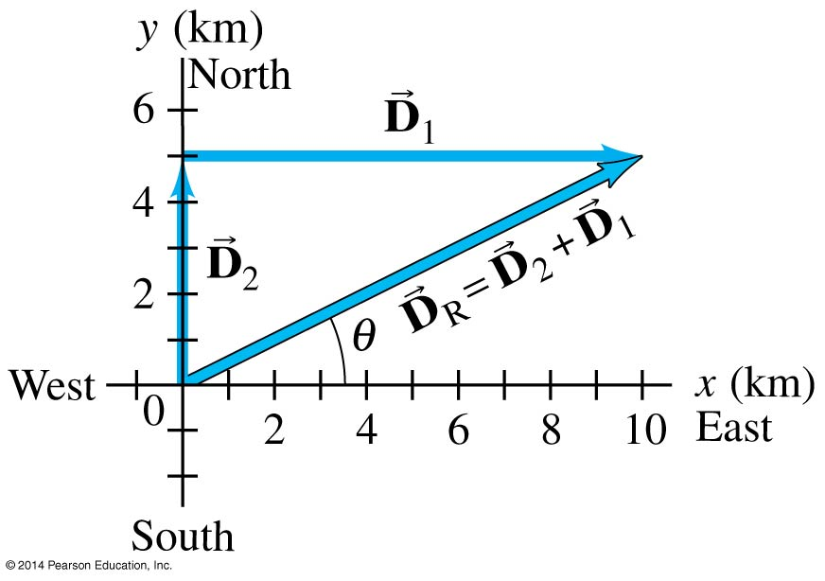
3-2 Addition of Vectors—Graphical Methods
Adding the vectors in the opposite order gives the same result:

Slide 7
3-2 Addition of Vectors—Graphical Methods
Even if the vectors are not at right angles, they can be added graphically by using the “tail-to-tip” method.

Slide 8
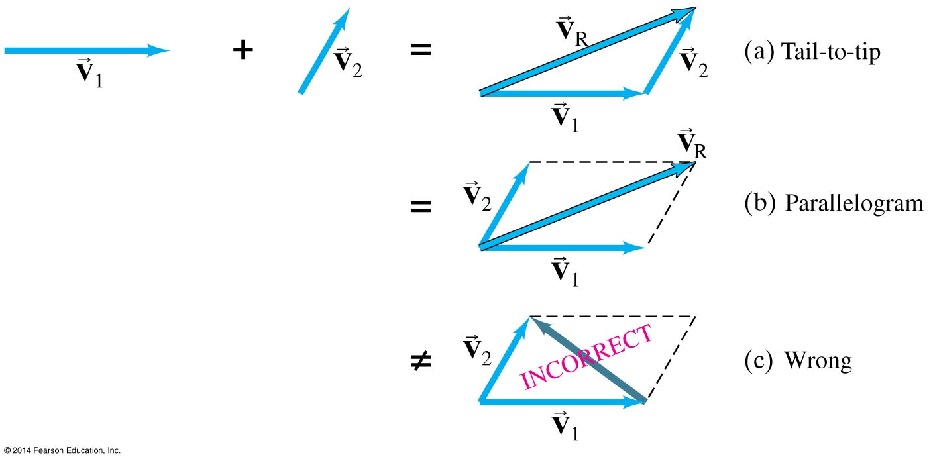
3-2 Addition of Vectors—Graphical Methods
The parallelogram method may also be used; here again the vectors must be “tail-to-tip.”

Slide 9
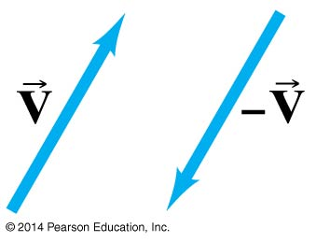
3-3 Subtraction of Vectors, and Multiplication of a Vector by a Scalar
In order to subtract vectors, we define the negative of a vector, which has the same magnitude but points in the opposite direction.
Then we add the negative vector:

Slide 10
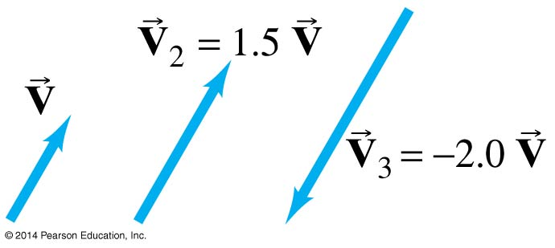
3-3 Subtraction of Vectors, and Multiplication of a Vector by a Scalar
A vector V can be multiplied by a scalar c; the result is a vector cV that has the same direction but a magnitude cV. If c is negative, the resultant vector points in the opposite direction.

Slide 11
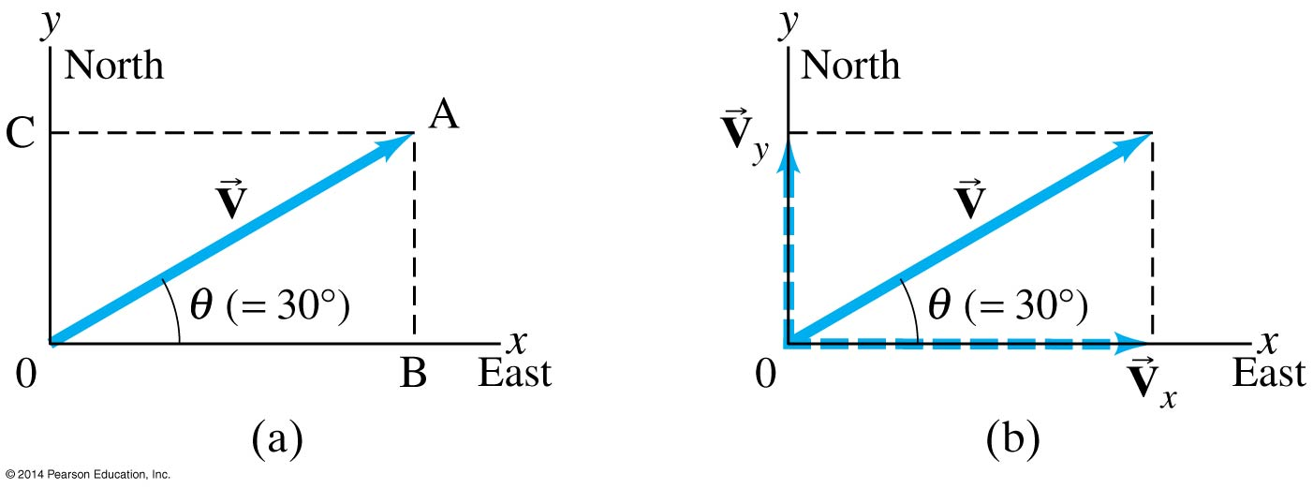
3-4 Adding Vectors by Components
Any vector can be expressed as the sum of two other vectors, which are called its components. Usually the other vectors are chosen so they are perpendicular to each other.

Slide 12
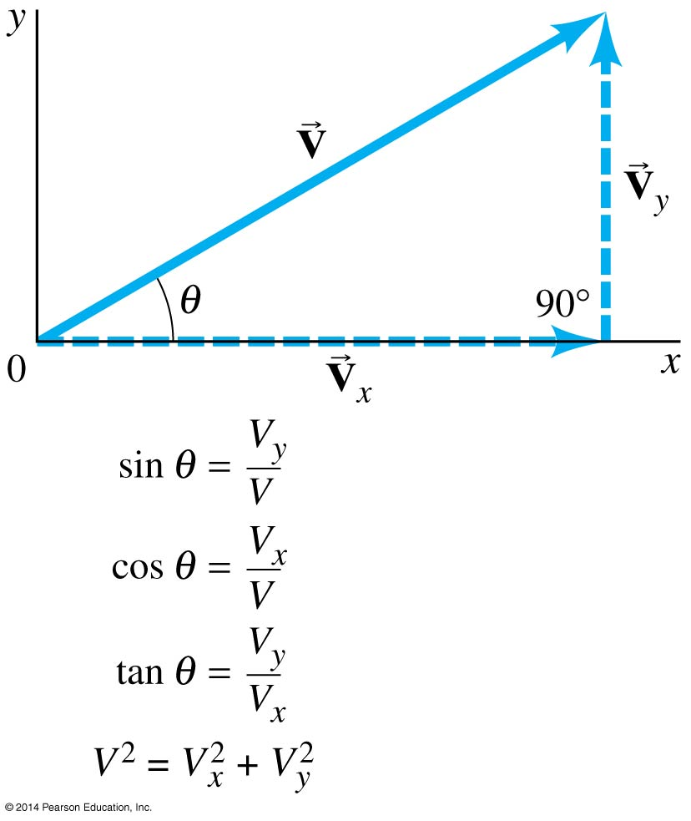
3-4 Adding Vectors by Components
If the components are perpendicular, they can be found using trigonometric functions.

Slide 13
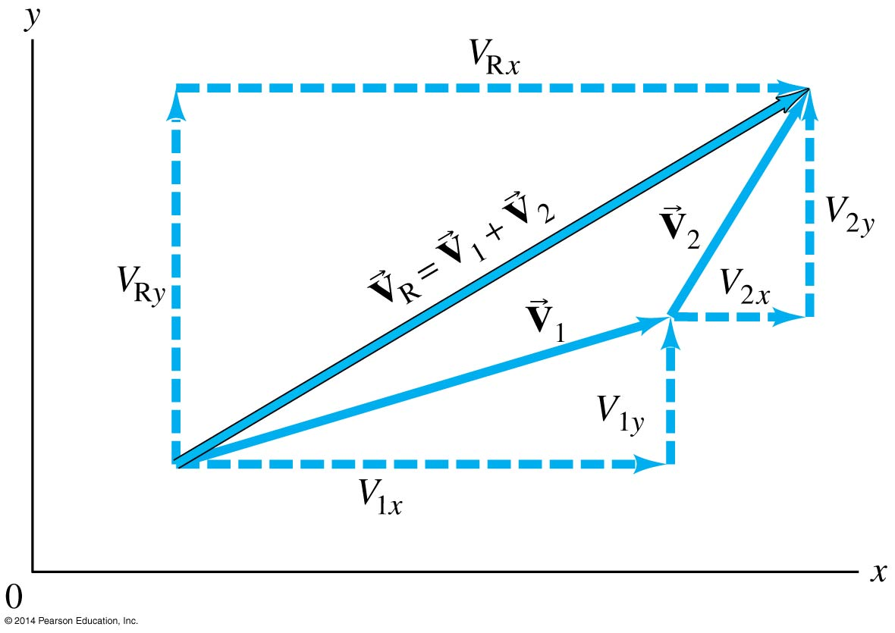
3-4 Adding Vectors by Components
The components are effectively one-dimensional, so they can be added arithmetically:

Slide 14
3-4 Adding Vectors by Components
Adding vectors:
Draw a diagram; add the vectors graphically.
Choose x and y axes.
Resolve each vector into x and y components.
Calculate each component using sines and cosines.
Add the components in each direction.
To find the length and direction of the vector, use:
(3-4a)
(3-4b)

Slide 15
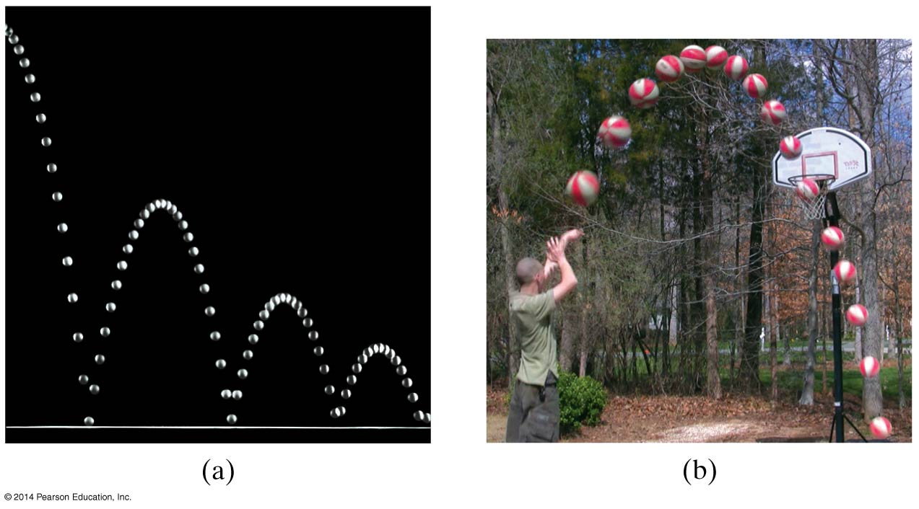
3-5 Projectile Motion
A projectile is an object moving in two dimensions under the influence of Earth’s gravity; its path is a parabola.

Slide 16
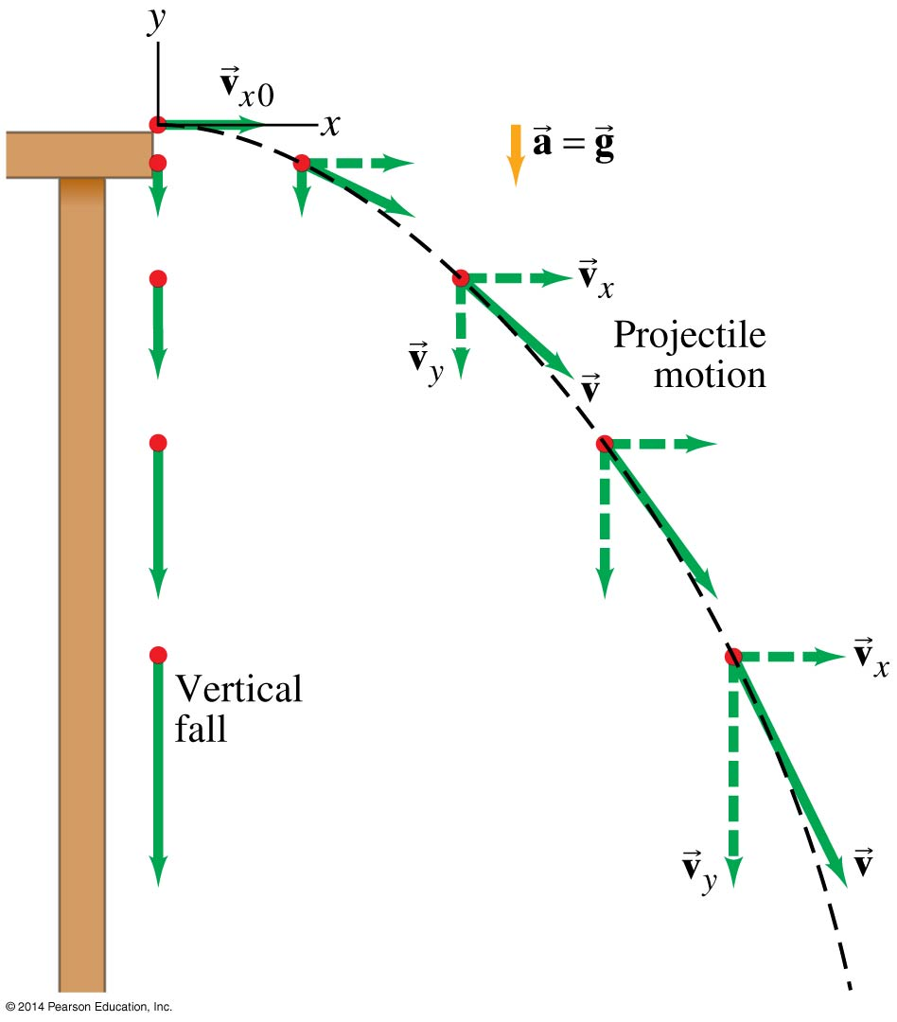
3-5 Projectile Motion
Projectile motion can be understood by analyzing the horizontal and vertical motions separately.

Slide 17
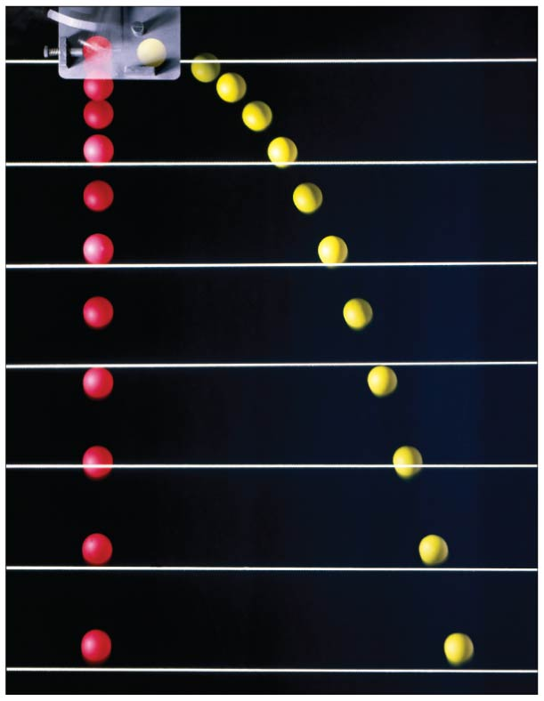
3-5 Projectile Motion
The speed in the x-direction is constant; in the y-direction the object moves with constant acceleration g.
This photograph shows two balls that start to fall at the same time. The one on the right has an initial speed in the x-direction. It can be seen that vertical positions of the two balls are identical at identical times, while the horizontal position of the yellow ball increases linearly.

Slide 18
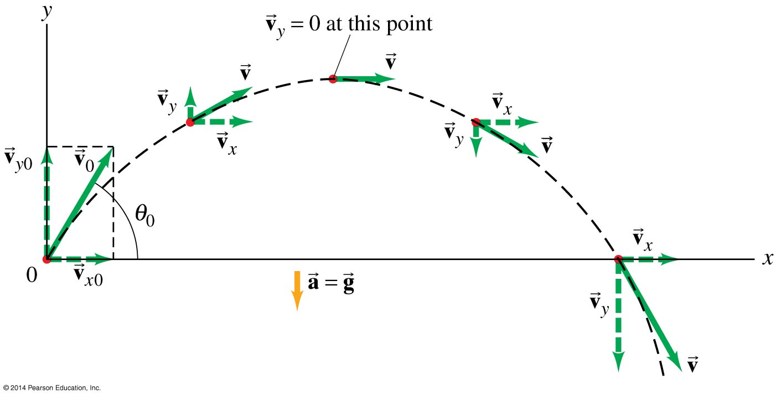
3-5 Projectile Motion
If an object is launched at an initial angle of θ₀ with the horizontal, the analysis is similar except that the initial velocity has a vertical component.

Slide 19
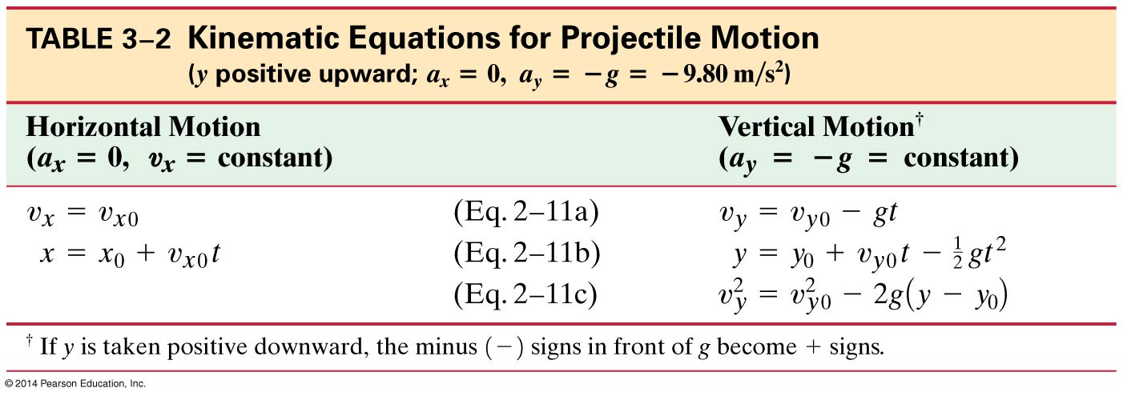
3-6 Solving Projectile Motion Problems
Projectile motion is motion with constant acceleration in two dimensions, where the acceleration is g and is down.

Slide 20
3-6 Solving Projectile Motion Problems
Read the problem carefully, and choose the object(s) you are going to analyze.
Draw a diagram.
Choose an origin and a coordinate system.
Decide on the time interval; this is the same in both directions, and includes only the time the object is moving with constant acceleration g.
Examine the x and y motions separately.

Slide 21
3-6 Solving Projectile Motion Problems
List known and unknown quantities. Remember that v_{x} never changes, and that v_{y} = 0 at the highest point.
Plan how you will proceed. Use the appropriate equations; you may have to combine some of them.

Slide 22
3-7 Projectile Motion Is Parabolic
In order to demonstrate that projectile motion is parabolic, we need to write y as a function of x. When we do, we find that it has the form:
y = Ax – Bx²
This is indeed the equation for a parabola.

Slide 23
3-8 Relative Velocity
We already considered relative speed in one dimension; it is similar in two dimensions except that we must add and subtract velocities as vectors.
Each velocity is labeled first with the object, and second with the reference frame in which it has this velocity. In the following example, v_{WS} is the velocity of the water in the shore frame, v_{BS} is the velocity of the boat in the shore frame, and v_{BW} is the velocity of the boat in the water frame.

Slide 24
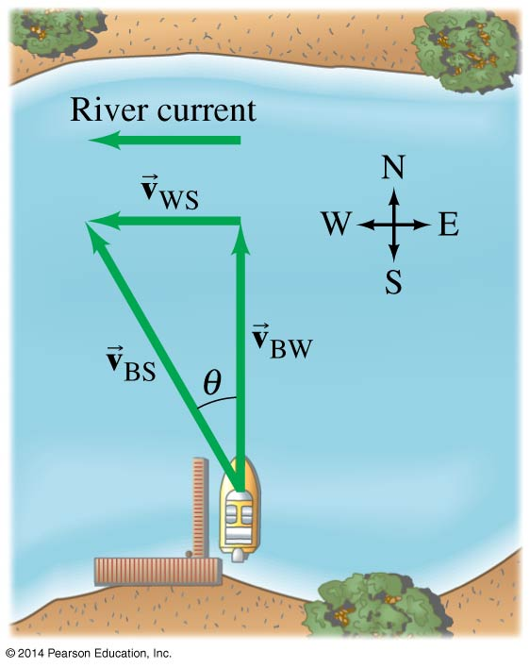
3-8 Relative Velocity
In this case, the relationship between the three velocities is:
(3-7)

Slide 25
Summary of Chapter 3
A quantity with magnitude and direction is a vector.
A quantity with magnitude but no direction is a scalar.
Vector addition can be done either graphically or using components.
The sum is called the resultant vector.
Projectile motion is the motion of an object near the Earth’s surface under the influence of gravity.

