Slide 1
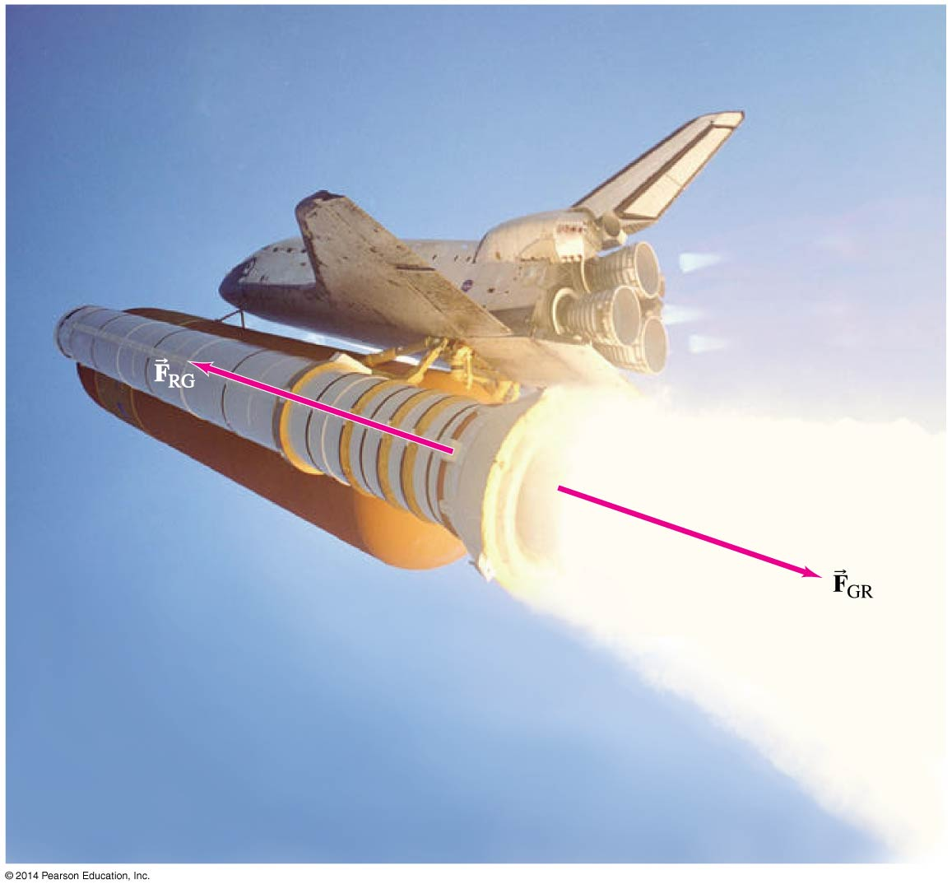
Chapter 4
Dynamics:
Aim: How can we describe Newton’s Laws of Motion?

Slide 2
Aim: How can we describe a force?
Do Now: What is my weight?
DO NOT TELL ANYBODY
My mass is 82 kg.
Calculate the weight of a person having mass of 82 kg.

Slide 3
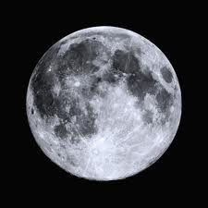
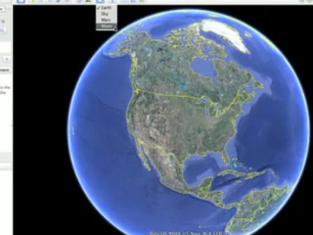
WEIGHT
The amount of gravitational force an object experiences.
The mass does not change, the weight changes.
The acceleration due to gravity on the surface of the Earth is g = 9.81 m/s² .
^{LOCATE THE WEIGHT FORMULA}

Slide 4
Fg = m * g

Slide 5

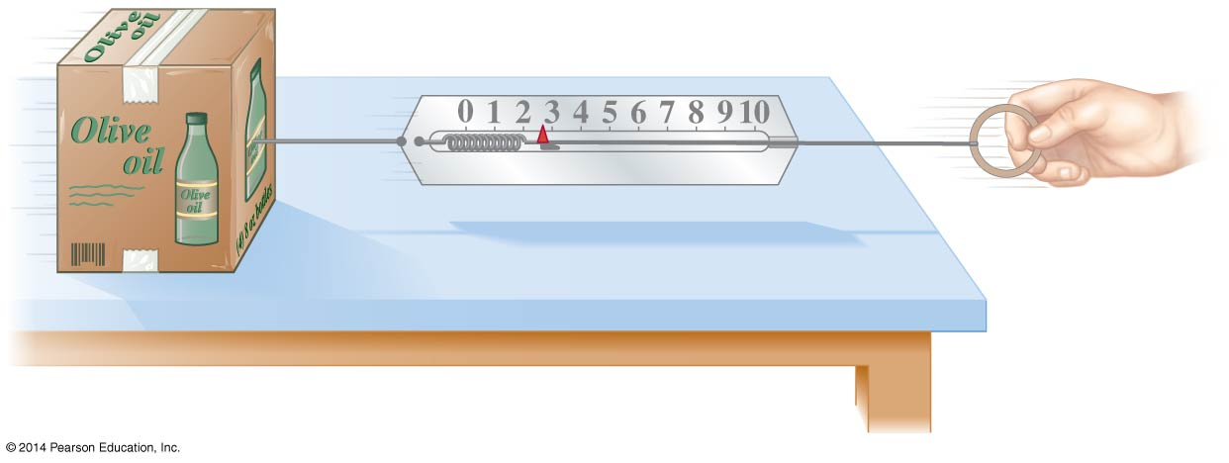
4-1 Force
A force is a push or pull. An
object at rest needs a force
to get it moving; a moving
object needs a force to
change its velocity.
The magnitude of a force can be measured using a spring scale.

Slide 6
FREE BODY DIAGRAM
● A free body diagram is just a simple sketch of the object showing all the forces that are acting on it.
● To draw a proper free body diagram, you must follow these steps:
1. Draw a dot representing the object.
2. For every force acting on that object draw a vector that shows the direction. Each vector must start from the dot and point outwards.
3. Label each vector based on the type of force it is.

Slide 7
Example 1: Sketch a free body diagram for a book being held up by a person.

Slide 8
Example 1: Sketch a free body diagram for a book being held up by a person.

Slide 9
FORCE
F net is the sum of all forces.

Slide 10
Example 2: Sketch a free body diagram of a laptop sitting on a table.

Slide 11
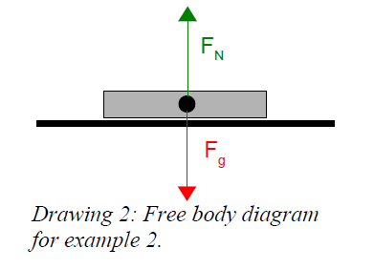
Example 2: Sketch a free body diagram of a laptop sitting on a table.
A normal force is exerted
upwards by a surface (like a table or a floor) and is perpendicular to the
surface.

Slide 12
You are trying to push a heavy box across the floor. You cannot move the box.

Slide 13
Force due to friction (F_{f})always opposes the motion of an object. It is parallel to the surface the object is on.

Slide 14
A sled is sliding down a sloped hill.

Slide 16
Derive Weight parallel and Weight perpendicular.

Slide 17
4-1 Force
A force is a push or pull. An
object at rest needs a force
to get it moving; a moving
object needs a force to
change its velocity.
The magnitude of a force can be measured using a spring scale.

Slide 18
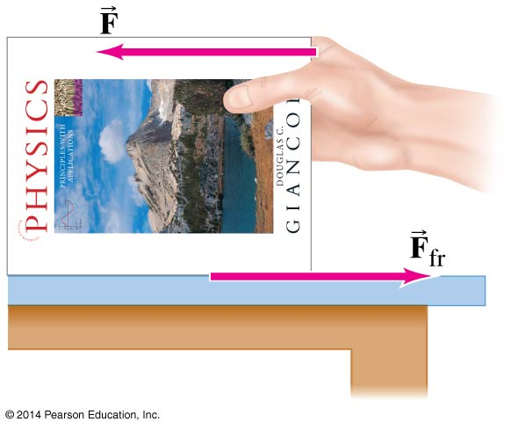
4-2 Newton’s First Law of Motion
Newton’s first law is often called the law of inertia.
Every object continues in its state of rest, or of uniform velocity in a straight line, as long as no net force acts on it.

Slide 19
4-2 Newton’s First Law of Motion
Inertial reference frames:
An inertial reference frame is one in which Newton’s first law is valid.
This excludes rotating and accelerating frames.

Slide 20
4-3 Mass
Mass is the measure of inertia of an object. In the SI system, mass is measured in kilograms.
Mass is not weight:
Mass is a property of an object. Weight is the force exerted on that object by gravity.
If you go to the moon, whose gravitational acceleration is about 1/6 g, you will weigh much less. Your mass, however, will be the same.

Slide 21
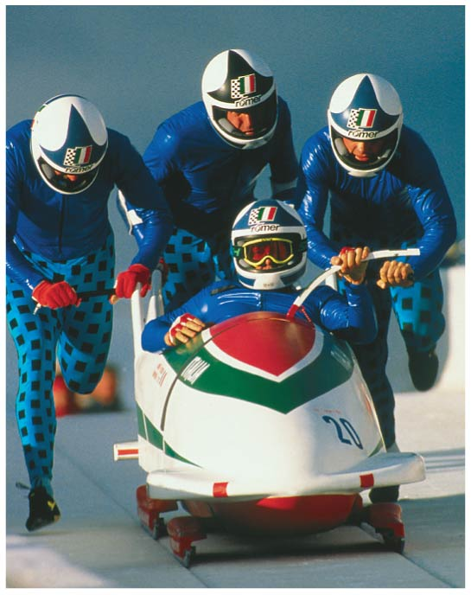
4-4 Newton’s Second Law of Motion
Newton’s second law is the relation between acceleration and force. Acceleration is proportional to force and inversely proportional to mass.
(4-1)

Slide 22
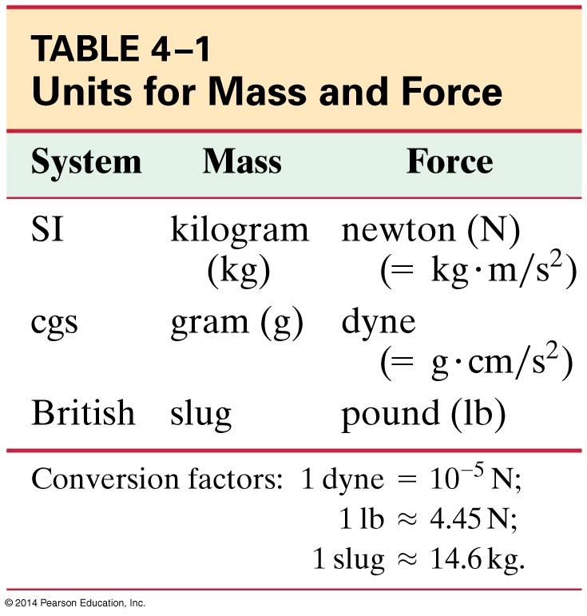
4-4 Newton’s Second Law of Motion
Force is a vector, so ΣF = ma is true along each coordinate axis.
The unit of force in the SI
system is the newton (N).
Note that the pound is a unit
of force, not of mass, and
can therefore be equated to
newtons but not to kilograms.

Slide 23
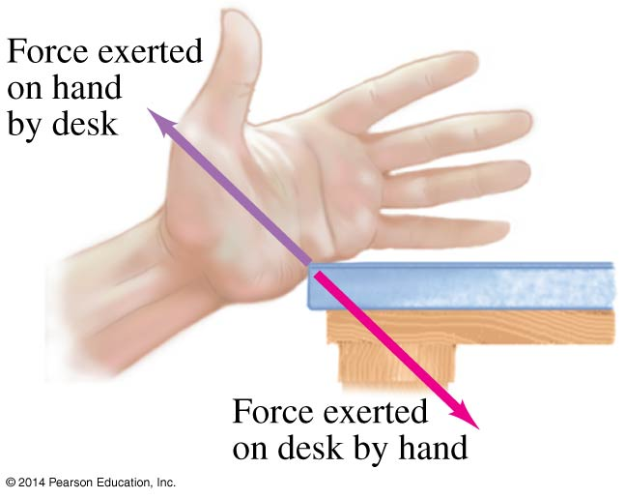
4-5 Newton’s Third Law of Motion
Any time a force is exerted on an object, that force is caused by another object.
Newton’s third law:
Whenever one object exerts
a force on a second object,
the second exerts an equal
force in the opposite
direction on the first.

Slide 24
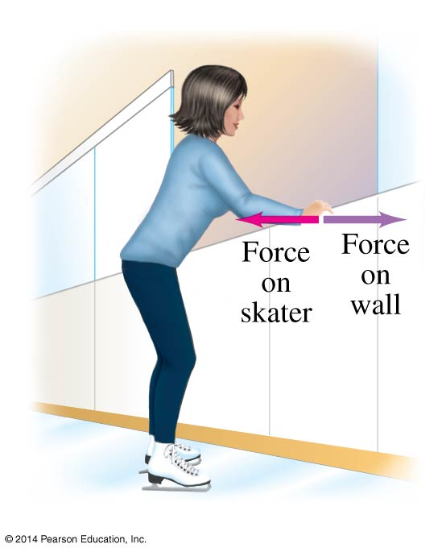
4-5 Newton’s Third Law of Motion
A key to the correct application of the third law is that the forces are exerted on different objects. Make sure you don’t use them as if they were acting on the same object.

Slide 25
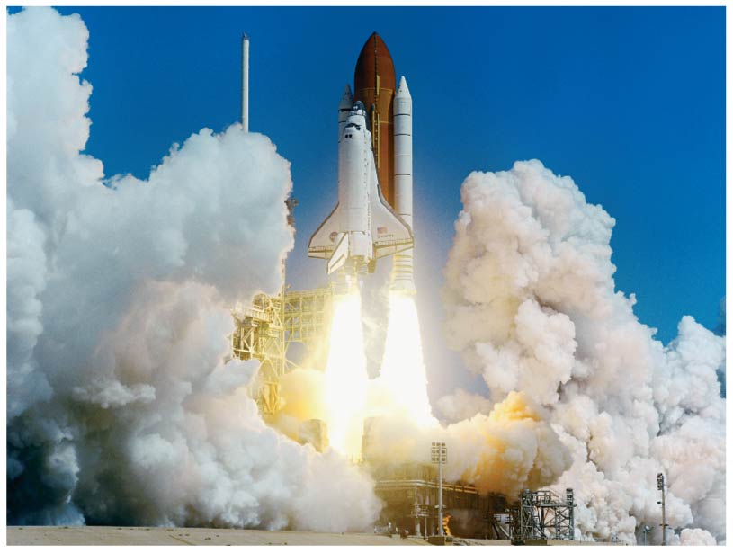
4-5 Newton’s Third Law of Motion
Rocket propulsion can also be explained using Newton’s third law: hot gases from combustion spew out of the tail of the rocket at high speeds. The reaction force is what propels the rocket.
Note that the rocket
does not need anything
to “push” against.

Slide 26
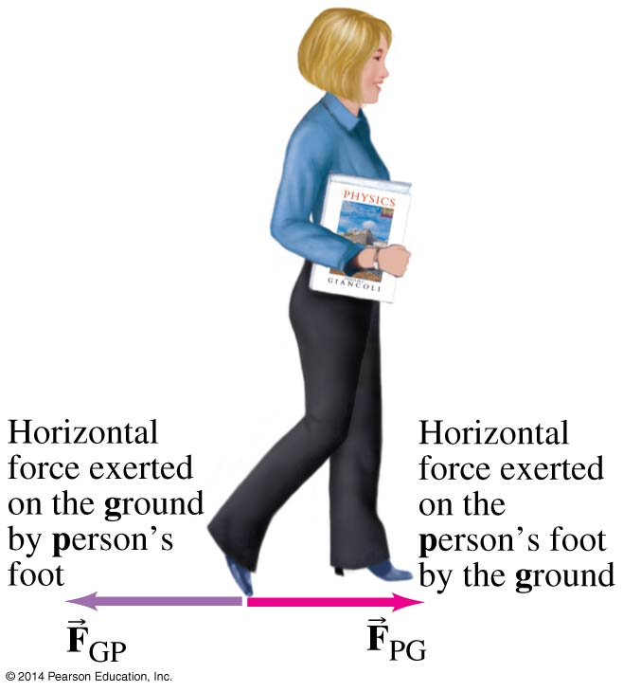
4-5 Newton’s Third Law of Motion
Helpful notation: the first subscript is the object that the force is being exerted on; the second is the source.
This need not be done indefinitely, but is a good idea until you get used to dealing with these forces.
(4-2)

Slide 27
4-6 Weight—the Force of Gravity; and the Normal Force
Weight is the force exerted on an object by gravity. Close to the surface of the Earth, where the gravitational force is nearly constant, the weight is:
(4-3)

Slide 28
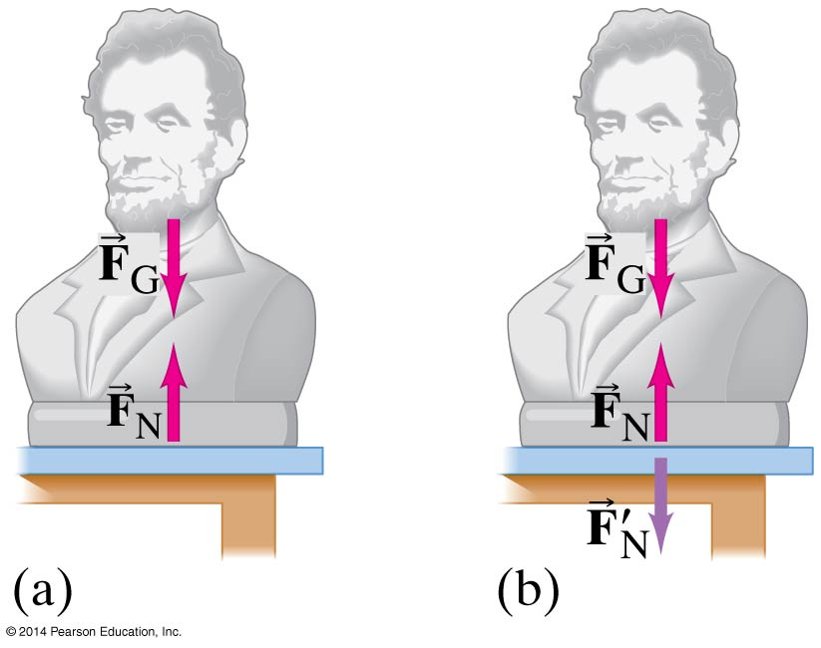
4-6 Weight—the Force of Gravity; and the Normal Force
An object at rest must have no net force on it. If it is sitting on a table, the force of gravity is still there; what other force is there?
The force exerted
perpendicular to a surface
is called the normal force.
It is exactly as large as
needed to balance the force
from the object (if the
required force gets too big,
something breaks!)

Slide 29
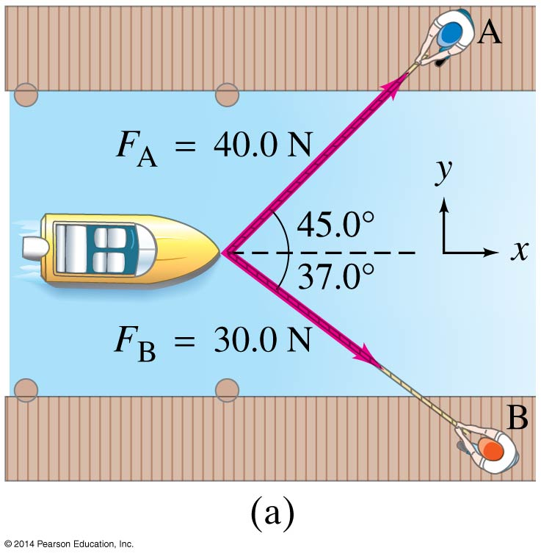
4-7 Solving Problems with Newton’s Laws— Free-Body Diagrams
Draw a sketch.
For one object, draw a free-body diagram, showing all the forces acting on the object. Make the magnitudes and directions as accurate as you can. Label each force. If there are multiple objects, draw a separate diagram for each.

Slide 30
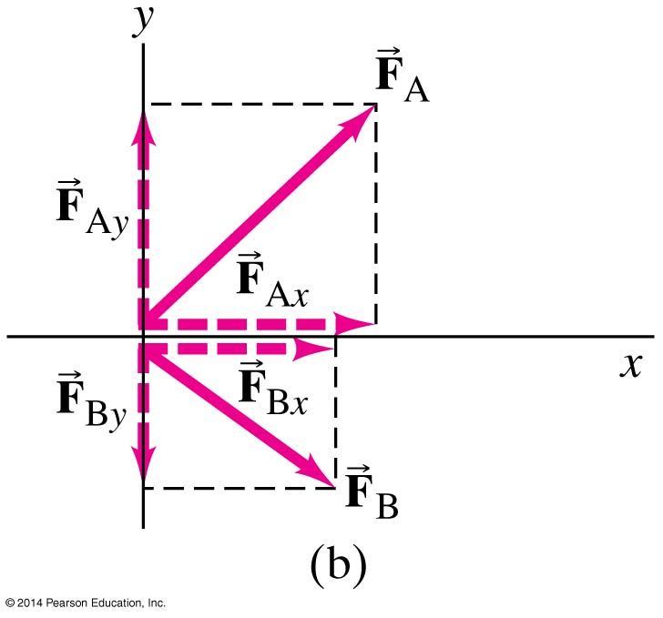
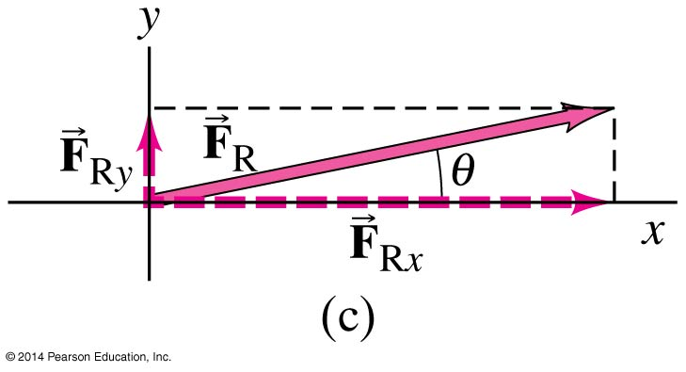
4-7 Solving Problems with Newton’s Laws— Free-Body Diagrams
Resolve vectors into components.
Apply Newton’s second law to each component.
Solve.

Slide 31
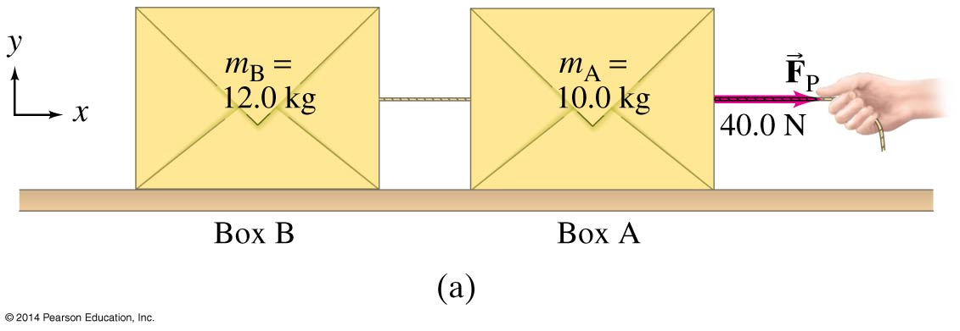
4-7 Solving Problems with Newton’s Laws— Free-Body Diagrams
When a cord or rope pulls on an object, it is said to be under tension, and the force it exerts is called a tension force.

Slide 32
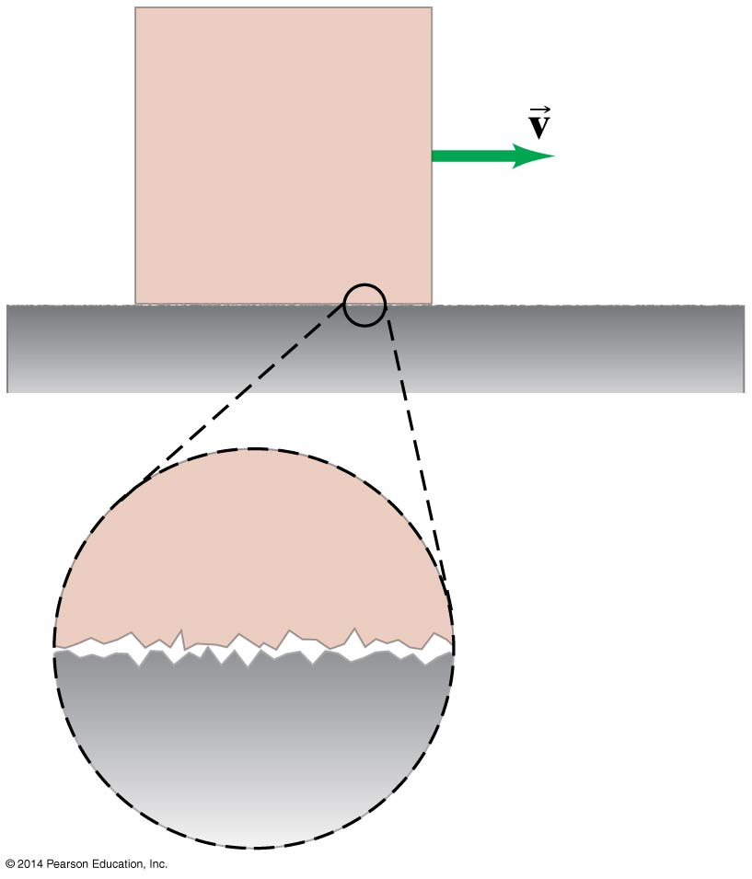

4-8 Problems Involving Friction, Inclines
On a microscopic scale, most surfaces are rough. The exact details are not yet known, but the force can be modeled in a simple way.
For kinetic—sliding—friction, we write:
μ_{k} is the coefficient of kinetic friction, and is different for every pair of surfaces.

Slide 33
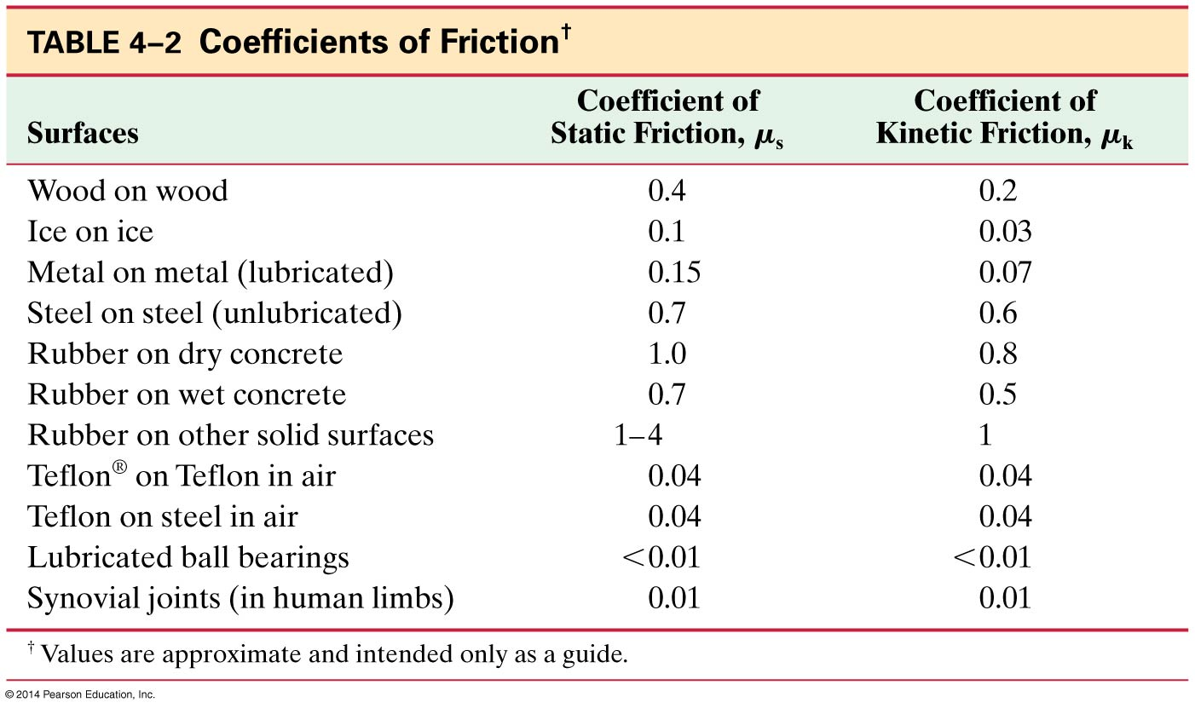
4-8 Problems Involving Friction, Inclines
This table lists the measured values of some coefficients of friction. Note that the coefficient depends on both surfaces.

Slide 34

4-8 Problems Involving Friction, Inclines
Static friction is the frictional force between two surfaces that are not moving along each other. Static friction keeps objects on inclines from sliding, and keeps objects from moving when a force is first applied.

Slide 35
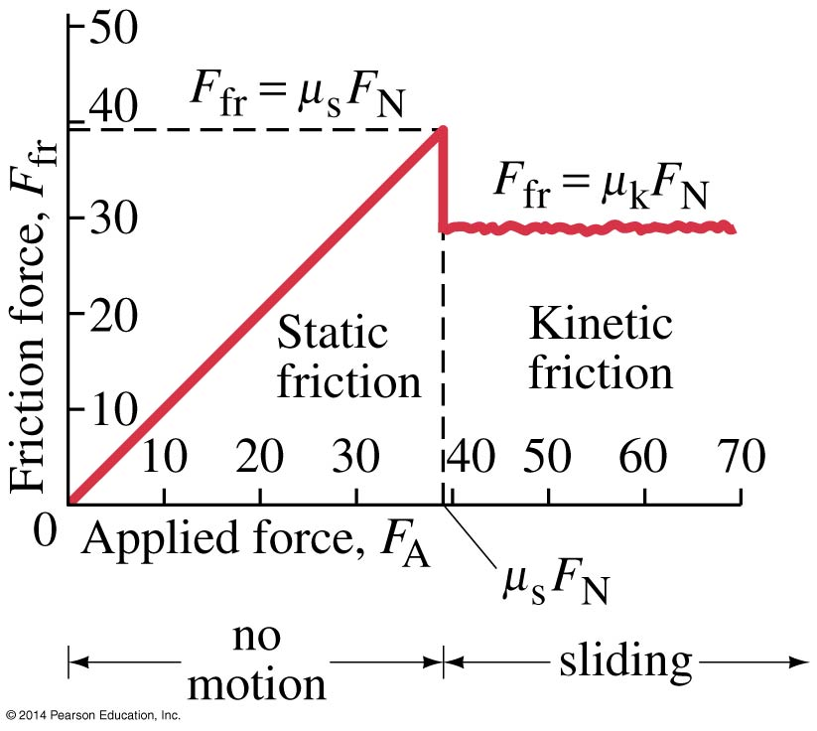
4-8 Problems Involving Friction, Inclines
The static frictional force increases as the applied force increases, until it reaches its maximum. Then the object starts to move, and the kinetic frictional force takes over.

Slide 36
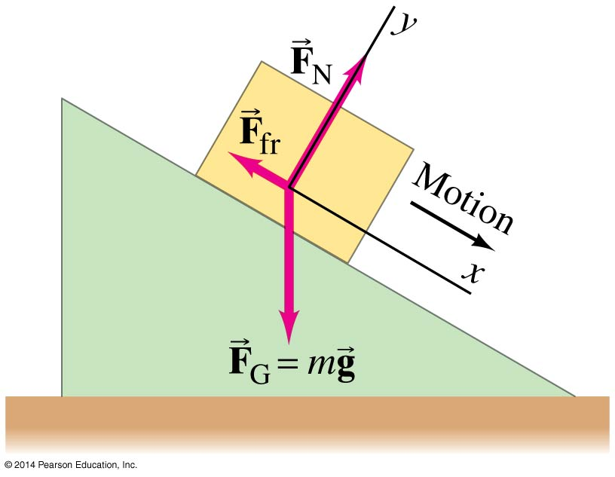
4-8 Problems Involving Friction, Inclines
An object sliding down an incline has three forces acting on it: the normal force, gravity, and the frictional force.
The normal force is always perpendicular to the surface.
The friction force is parallel to it.
The gravitational force
points down.
If the object is at rest, the forces are
the same except that we use the static
frictional force, and the sum of the
forces is zero.

Slide 37
Summary of Chapter 4
Newton’s first law: If the net force on an object is zero, it will remain either at rest or moving in a straight line at constant speed.
Newton’s second law:
Newton’s third law:
Weight is the gravitational force on an object.
The frictional force can be written F_{fr} = μ_{k}F_{N} (kinetic friction) or F_{fr} ≤ μ_{s}F_{N} (static friction)
(4-1)
(4-2)

Slide 38
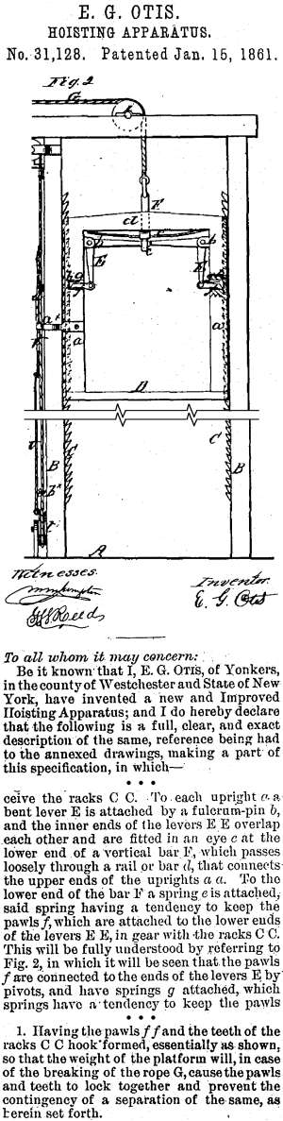
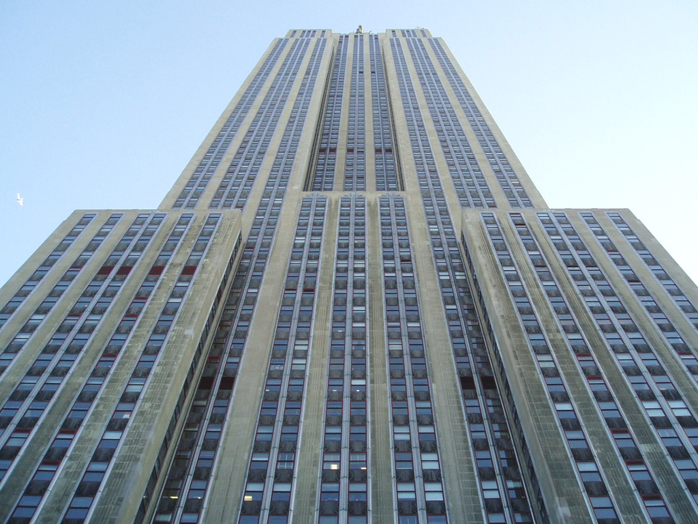
Aim: How can we solve problems applying the Laws of Motion?d27
Do Now: Describe the apparent weight when you ride an elevator at the Empire State Building.

Slide 39
Fastest elevator in Taipei 1010 m / min, 36 sec 101 floors. Empire State Building 426 m / min.
1st Floor:
2 – 25:
26 – 70:
71 – 86:
86th Floor:

Slide 40
Aim: How can we describe system of bodies?
Do Now:
A 45 N force is applied to a 30 kg block resting on a horizontal frictionless table. Find the acceleration?

Slide 41
A 45 N force is applied to a 30 kg block resting on a horizontal frictionless table. Find the acceleration?
Draw a free body diagram.
a = Fnet / m

Slide 42
Now place the 30 kg object on an 30 degree frictionless inclined plane. Calculate the acceleration.
Draw a free body diagram
The accelerating force is the F_{net} which is the weight parallel.
Suppose there is friction between the object and the inlcined , μ_{k} is 0.2.
The accelerating force is the F_{net} = F_{g//} - F_{f}

Slide 43
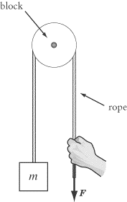
Pulley
Pulleys are simple machines that consist of a rope that slides around a disk, called a block. Their main function is to change the direction of the tension force in a rope.

Slide 44
Two masses moving together
A 5.0-kg and a 10.0-kg box are touching each other. A 45.0-N horizontal force is applied to the 5.0-kg box in order to accelerate both boxes across the floor. Ignore friction forces and determine the acceleration of the boxes and the force acting between the boxes.
The magnitude of the force of gravity is m•g or 147 N.
The magnitude of the normal force is also 147 N since it must support the weight (147 N) of the system.
Newton's second law (a = F_{net}/m) can be used to determine the acceleration.
Using 45.0 N for F_{net} and 15.0 kg for m, the acceleration is 3.0 m/s².
System of bodies: Two or more objects moving together.
ACCELERATION IS THE SAME ON BOTH OBJECTS.
If objects are connected with a rope then they have SAME TENSION.

Slide 45
Aim: How can we calculate the acceleration and tension on system of bodies?

Slide 46
Place a 10kg mass on frictionless 35 degree incline plane and attach a second 20 kg mass via a cord to hang vertically as shown below. Calculate the acceleration of the system.
Draw free body diagrams; Identify all forces.
Both objects have same acceleration and tension force.
Calculate the Tension.

Slide 47
Calculate the acceleration and tension on the two blocks on the frictionless surfaces.
Notes:
alc

Slide 48
Atwood machine. Find the acceleration.

Slide 49
Calculate the tension and the acceleration of the system of bodies.

Slide 52
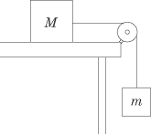
Two masses, m and M, are connected to a pulley system attached to a table, as in the diagram above. What is the minimum value for the coefficient of static friction between mass M and the table if the pulley system does not move?
(A) m/M
(B) M/m
(C) g (m/M)
(D) g (M/m)
(E) g(M – m)

Slide 53
1. A
If the pulley system doesn’t move, then the net force on both masses is zero. For mass m, that means that the force of gravity, mg, pulling it downward, is equal to the force of tension in the rope, pulling it upward. If the force of tension pulling mass m upward is mg, then the force of tension pulling mass M toward the edge of the table is also mg. That means that the force of static friction resisting the pull of the rope must also equal mg. The force of static friction for mass M is Mg, where is the coefficient of static friction. Since this force must be equal to mg, we can readily solve for :

Slide 54

μMg = m g

Slide 55

Draw a free body diagram
A mover pushes a box up an inclined plane.

