Slide 1
Chapter 2 Describing Motion: Kinematics in One Dimension

Slide 2
Contents of Chapter 2
Reference Frames and Displacement
Average Velocity
Instantaneous Velocity
Acceleration
Motion at Constant Acceleration
Solving Problems
Freely Falling Objects
Graphical Analysis of Linear Motion

Slide 3
2-1 Reference Frames and Displacement
Any measurement of position, distance, or speed must be made with respect to a reference frame.
For example, if you are sitting on a train and someone walks down the aisle, their speed with respect to the train is a few miles per hour, at most. Their speed with respect to the ground is much higher.

Slide 4
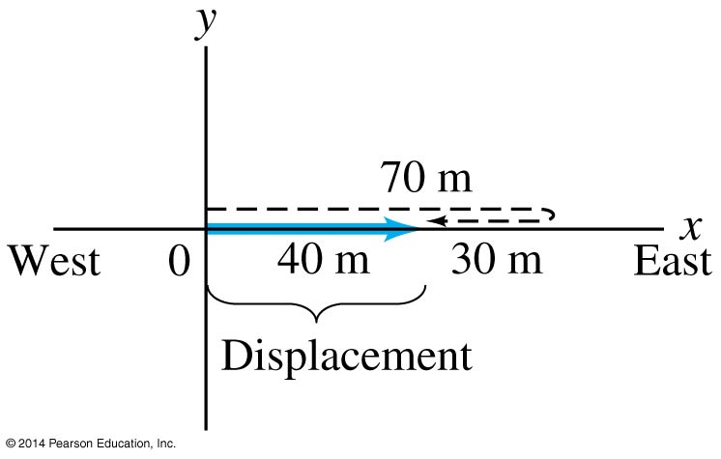
2-1 Reference Frames and Displacement
We make a distinction between distance and displacement.
Displacement (blue line) is how far the object is from its starting point, regardless of how it got there.
Distance traveled (dashed line) is measured along the actual path.

Slide 5
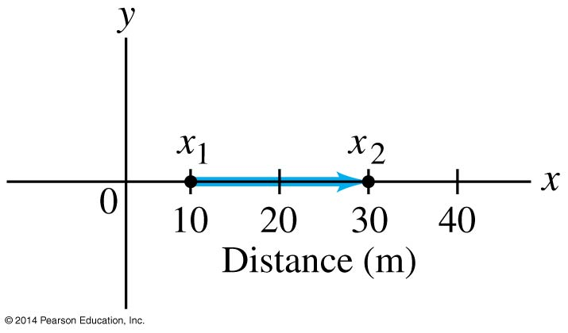
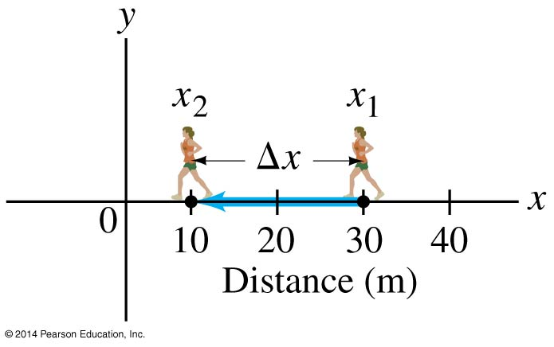
2-1 Reference Frames and Displacement
The displacement is written: ∆x = x₂ − x₁
Left: Displacement is positive. Right: Displacement is negative.

Slide 6
2-2 Average Velocity
Speed: how far an object travels in a given time interval
Velocity includes directional information:
(2-1)

Slide 7
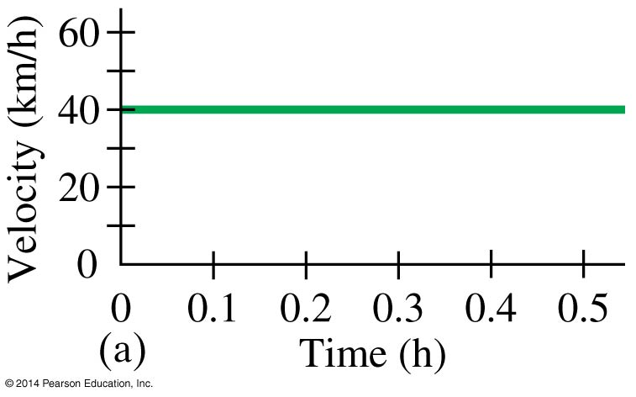
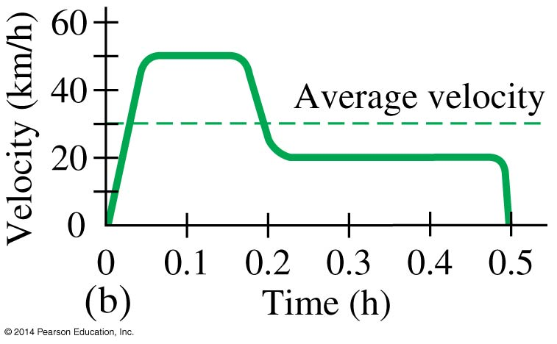
2-3 Instantaneous Velocity
The instantaneous velocity is the average velocity, in the limit as the time interval becomes infinitesimally short.
These graphs show (a) constant velocity and (b) varying velocity.
(2-3)

Slide 8
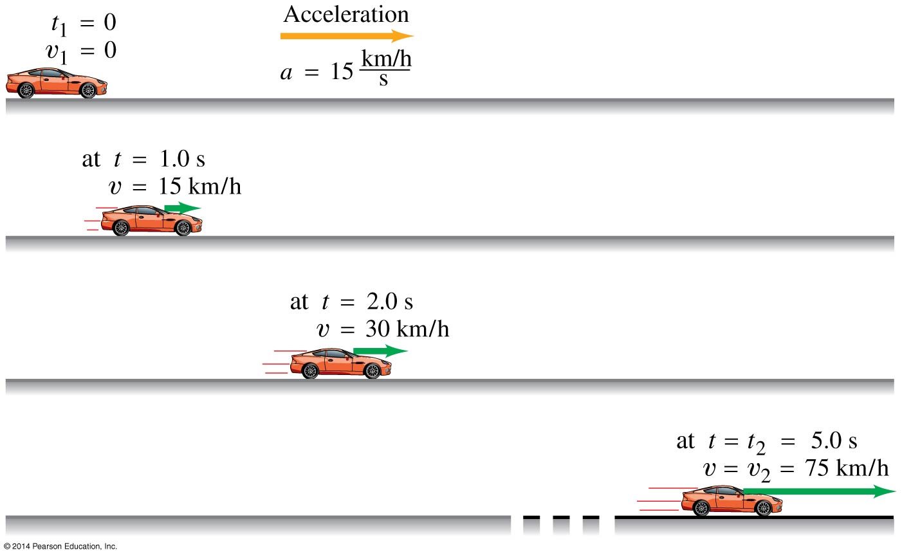
2-4 Acceleration
Acceleration is the rate of change of velocity.

Slide 9
2-4 Acceleration
Acceleration is a vector, although in one-dimensional motion we only need the sign.
The previous image shows positive acceleration; here is negative acceleration:

Slide 10
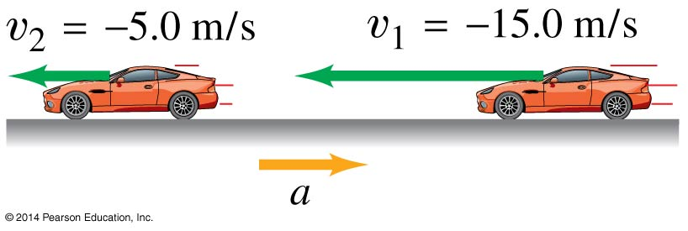
2-4 Acceleration
There is a difference between negative acceleration and deceleration:
Negative acceleration is acceleration in the negative direction as defined by the coordinate system.
Deceleration occurs when the acceleration is opposite in direction to the velocity.

Slide 11
2-4 Acceleration
The instantaneous acceleration is the average acceleration, in the limit as the time interval becomes infinitesimally short.
(2-5)

Slide 12
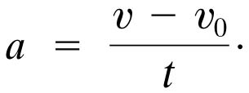
2-5 Motion at Constant Acceleration
The average velocity of an object during a time interval t is
The acceleration, assumed constant, is

Slide 13
2-5 Motion at Constant Acceleration
In addition, as the velocity is increasing at a constant rate, we know that
Combining these last three equations, we find:
(2-8)
(2-9)

Slide 14
2-5 Motion at Constant Acceleration
We can also combine these equations so as to eliminate t:
We now have all the equations we need to solve constant-acceleration problems.
(2-10)
(2-11a)
(2-11c)
(2-11b)
(2-11d)

Slide 15
2-6 Solving Problems
Read the whole problem and make sure you understand it. Then read it again.
Decide on the objects under study and what the time interval is.
Draw a diagram and choose coordinate axes.
Write down the known (given) quantities, and then the unknown ones that you need to find.
What physics applies here? Plan an approach to a solution.

Slide 16
2-6 Solving Problems
Which equations relate the known and unknown quantities? Are they valid in this situation? Solve algebraically for the unknown quantities, and check that your result is sensible (correct dimensions).
Calculate the solution and round it to the appropriate number of significant figures.
Look at the result—is it reasonable? Does it agree with a rough estimate?
Check the units again.

Slide 17
2-7 Freely Falling Objects
Near the surface of the Earth, all objects experience approximately the same acceleration due to gravity.
This is one of the most common examples of motion with constant acceleration.

Slide 18
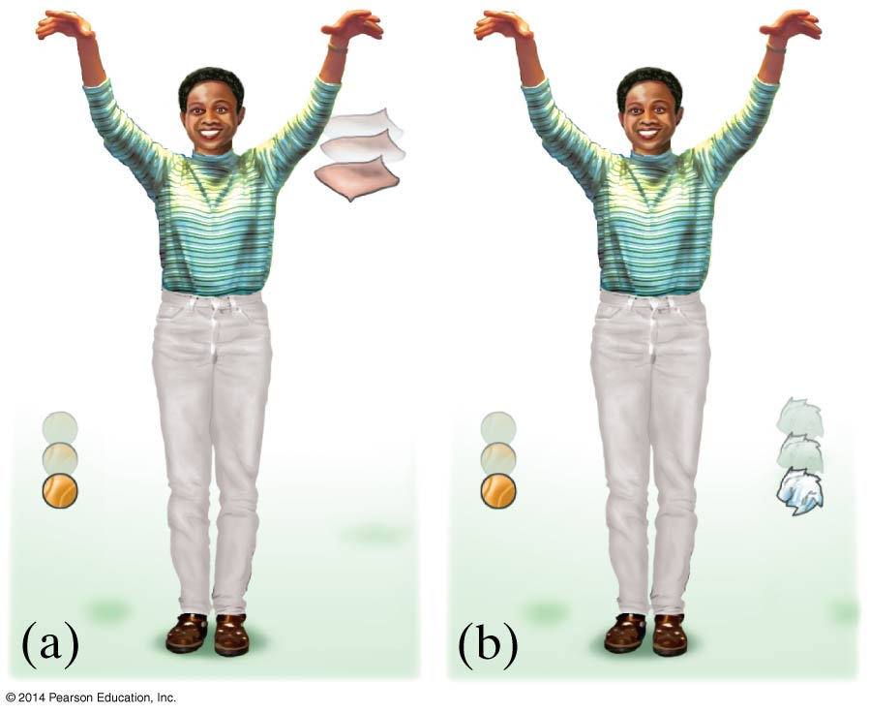
2-7 Freely Falling Objects
In the absence of air resistance, all objects fall with the same acceleration, although this may be hard to tell by testing in an environment where there is air resistance.

Slide 19
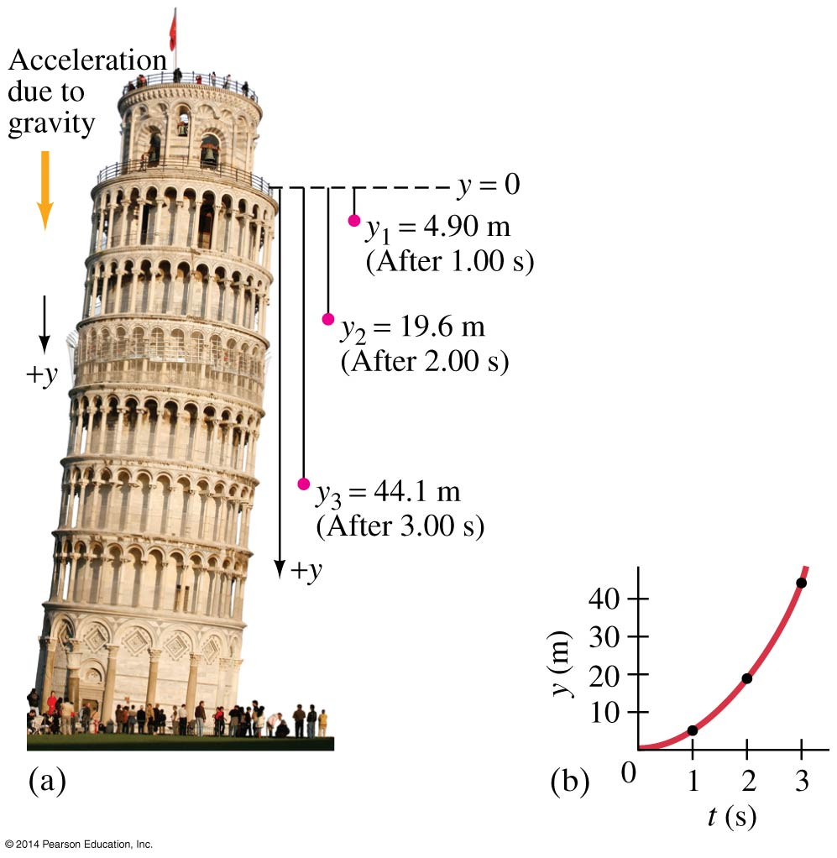
2-7 Freely Falling Objects
The acceleration due to gravity at the Earth’s surface is approximately 9.80 m/s².

Slide 20
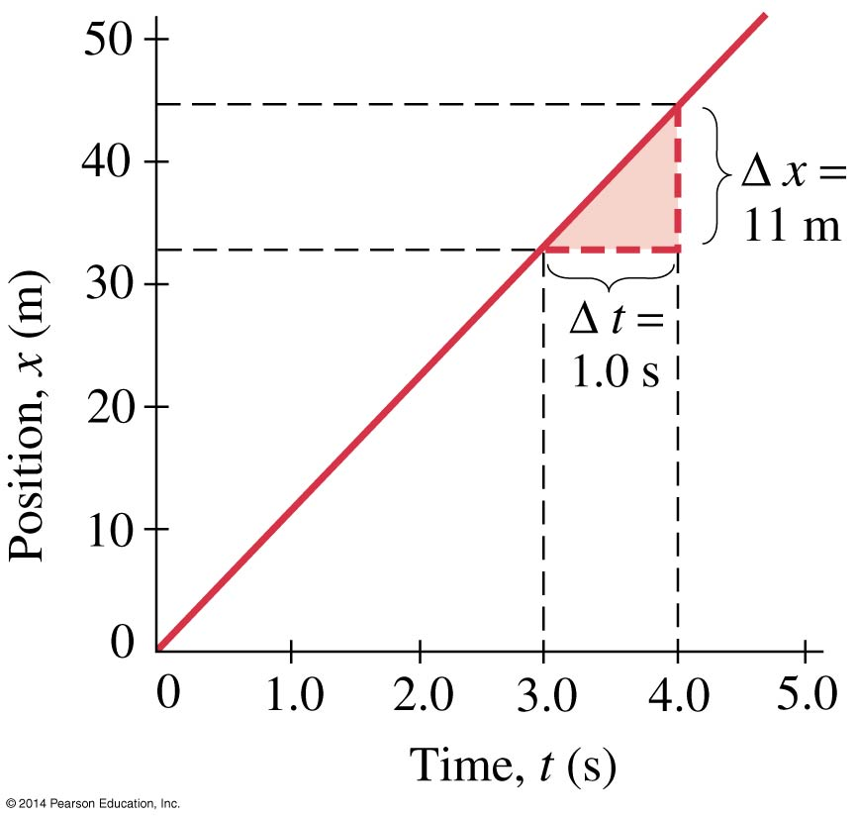
2-8 Graphical Analysis of Linear Motion
This is a graph of x vs. t for an object moving with constant velocity. The velocity is the slope of the x-t curve.

Slide 21
Summary of Chapter 2
Kinematics is the description of how objects move with respect to a defined reference frame.
Displacement is the change in position of an object.
Average speed is the distance traveled divided by the time it took; average velocity is the displacement divided by the time.
Instantaneous velocity is the limit as the time becomes infinitesimally short.

