Slide 1
Chapter 4 Dynamics: Newton’s Laws of Motion

Slide 2
Contents of Chapter 4
Force
Newton’s First Law of Motion
Mass
Newton’s Second Law of Motion
Newton’s Third Law of Motion
Weight—the Force of Gravity; and the Normal Force
Solving Problems with Newton’s Laws: Free-Body Diagrams
Problems Involving Friction, Inclines

Slide 3
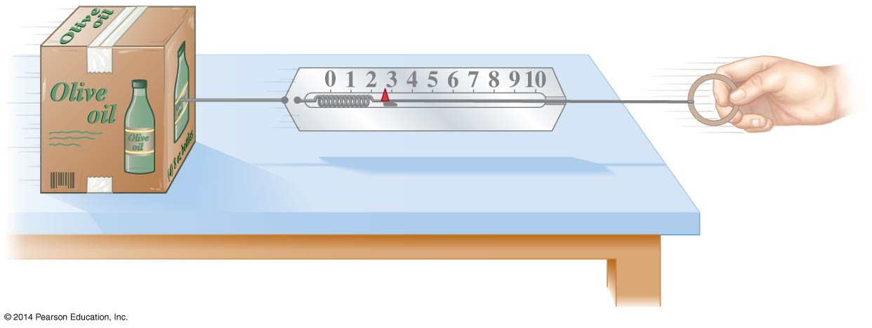
4-1 Force
A force is a push or pull. An object at rest needs a force to get it moving; a moving object needs a force to change its velocity.
The magnitude of a force can be measured using a spring scale.

Slide 4
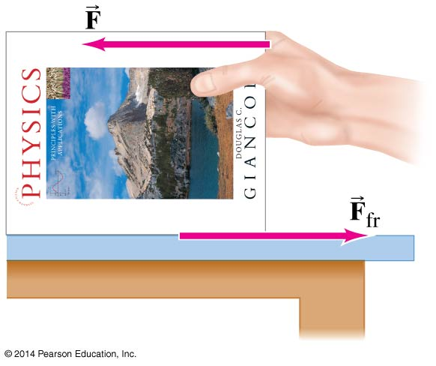
4-2 Newton’s First Law of Motion
Newton’s first law is often called the law of inertia.
Every object continues in its state of rest, or of uniform velocity in a straight line, as long as no net force acts on it.

Slide 5
4-2 Newton’s First Law of Motion
Inertial reference frames:
An inertial reference frame is one in which Newton’s first law is valid.
This excludes rotating and accelerating frames.

Slide 6
4-3 Mass
Mass is the measure of inertia of an object. In the SI system, mass is measured in kilograms.
Mass is not weight:
Mass is a property of an object. Weight is the force exerted on that object by gravity.
If you go to the moon, whose gravitational acceleration is about 1/6 g, you will weigh much less. Your mass, however, will be the same.

Slide 7
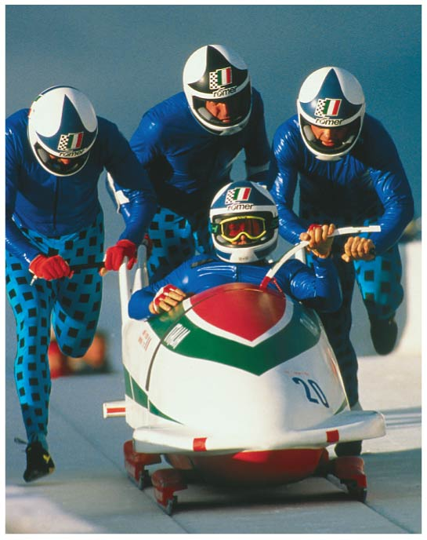
4-4 Newton’s Second Law of Motion
Newton’s second law is the relation between acceleration and force. Acceleration is proportional to force and inversely proportional to mass.
(4-1)

Slide 8
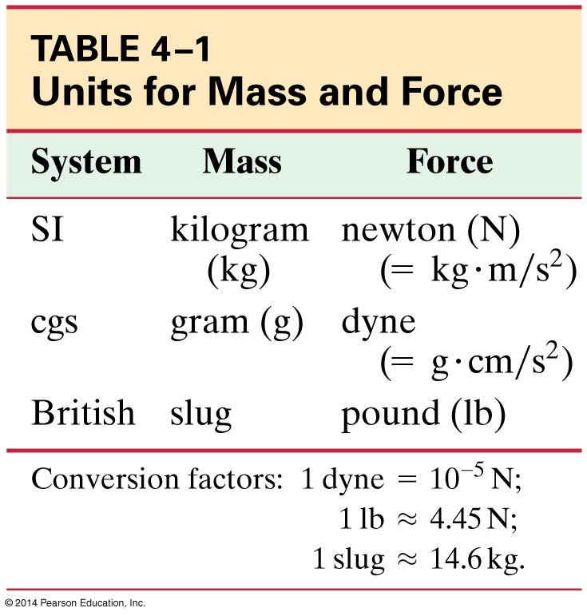
4-4 Newton’s Second Law of Motion
Force is a vector, so ΣF = ma is true along each coordinate axis.
The unit of force in the SI system is the newton (N).
Note that the pound is a unit of force, not of mass, and can therefore be equated to newtons but not to kilograms.

Slide 9
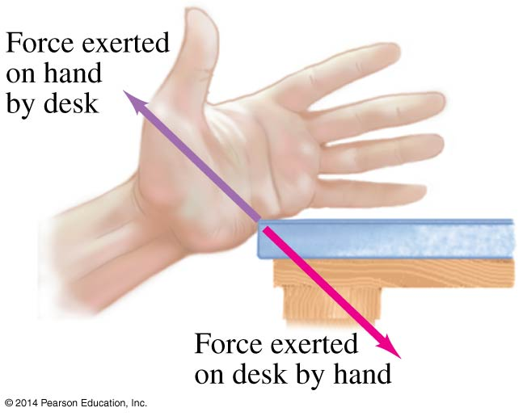
4-5 Newton’s Third Law of Motion
Any time a force is exerted on an object, that force is caused by another object.
Newton’s third law:
Whenever one object exerts a force on a second object, the second exerts an equal force in the opposite direction on the first.

Slide 10
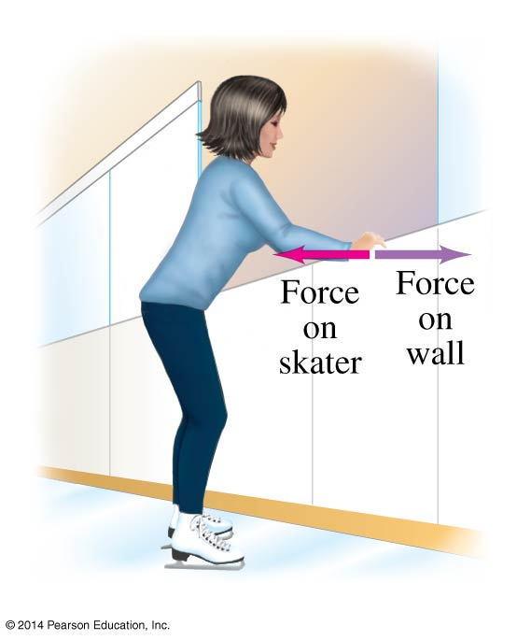
4-5 Newton’s Third Law of Motion
A key to the correct application of the third law is that the forces are exerted on different objects. Make sure you don’t use them as if they were acting on the same object.

Slide 11
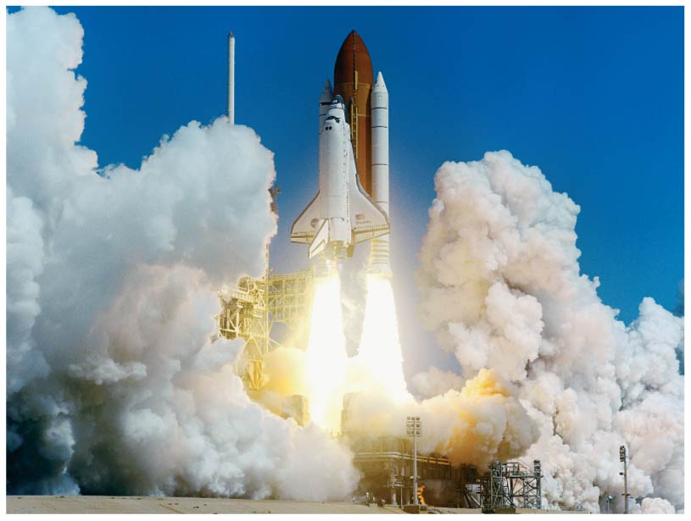
4-5 Newton’s Third Law of Motion
Rocket propulsion can also be explained using Newton’s third law: hot gases from combustion spew out of the tail of the rocket at high speeds. The reaction force is what propels the rocket.
Note that the rocket does not need anything to “push” against.

Slide 12
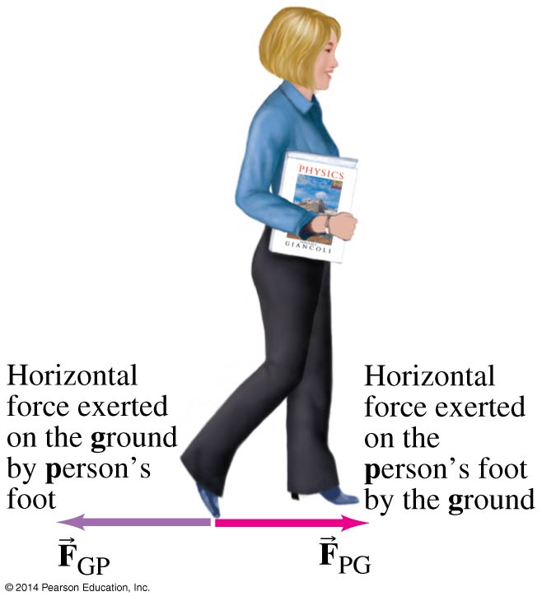
4-5 Newton’s Third Law of Motion
Helpful notation: the first subscript is the object that the force is being exerted on; the second is the source.
This need not be done indefinitely, but is a good idea until you get used to dealing with these forces.
(4-2)

Slide 13
4-6 Weight—the Force of Gravity; and the Normal Force
Weight is the force exerted on an object by gravity. Close to the surface of the Earth, where the gravitational force is nearly constant, the weight is:
(4-3)

Slide 14
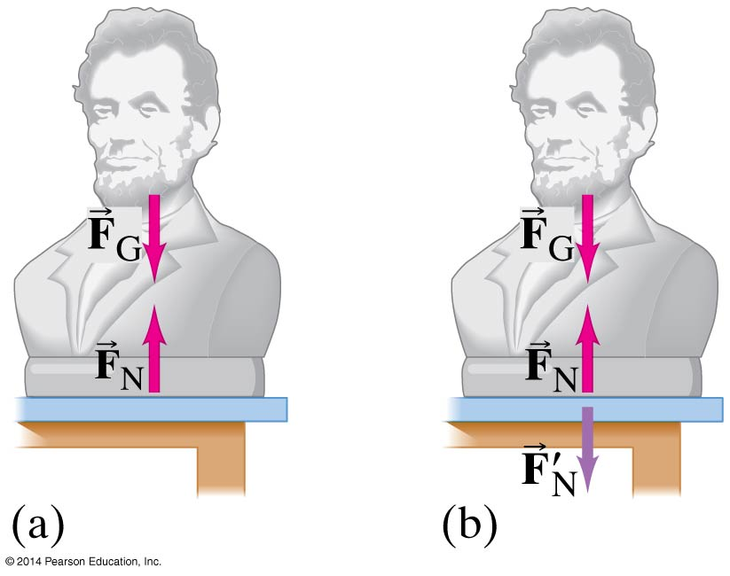
4-6 Weight—the Force of Gravity; and the Normal Force
An object at rest must have no net force on it. If it is sitting on a table, the force of gravity is still there; what other force is there?
The force exerted perpendicular to a surface is called the normal force. It is exactly as large as needed to balance the force from the object (if the required force gets too big, something breaks!)

Slide 15
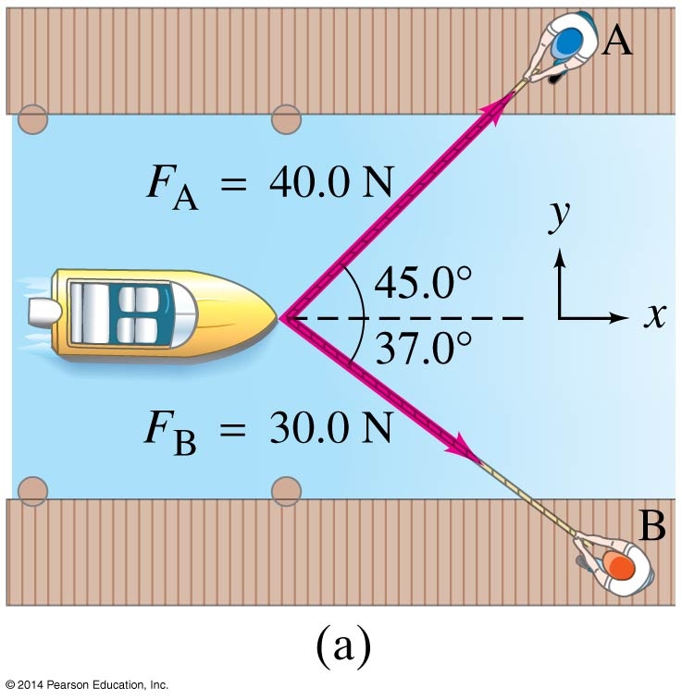
4-7 Solving Problems with Newton’s Laws— Free-Body Diagrams
Draw a sketch.
For one object, draw a free-body diagram, showing all the forces acting on the object. Make the magnitudes and directions as accurate as you can. Label each force. If there are multiple objects, draw a separate diagram for each.

Slide 16
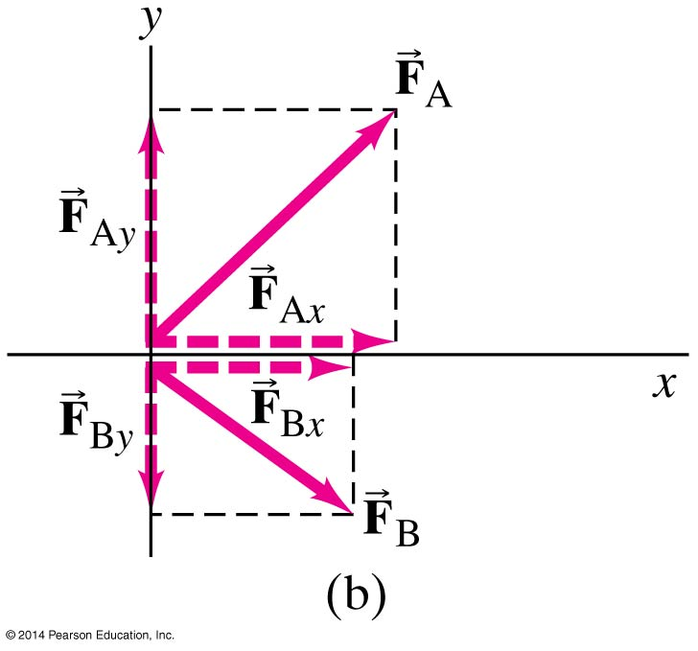
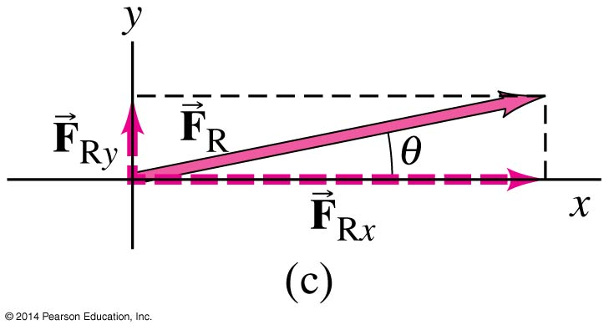
4-7 Solving Problems with Newton’s Laws— Free-Body Diagrams
Resolve vectors into components.
Apply Newton’s second law to each component.
Solve.

Slide 17
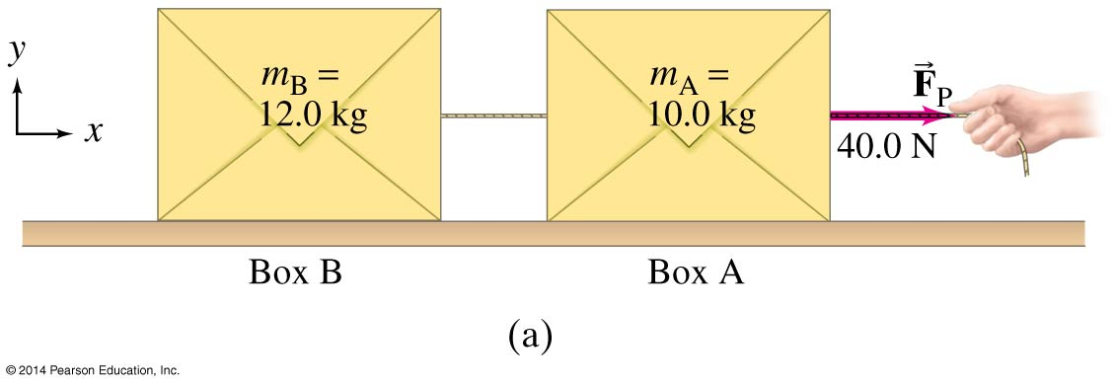
4-7 Solving Problems with Newton’s Laws— Free-Body Diagrams
When a cord or rope pulls on an object, it is said to be under tension, and the force it exerts is called a tension force.

Slide 18
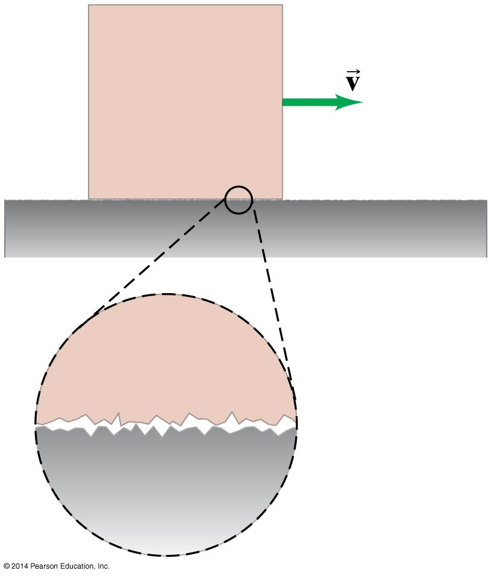
4-8 Problems Involving Friction, Inclines
On a microscopic scale, most surfaces are rough. The exact details are not yet known, but the force can be modeled in a simple way.
For kinetic—sliding—friction, we write:
μ_{k} is the coefficient of kinetic friction, and is different for every pair of surfaces.

Slide 19
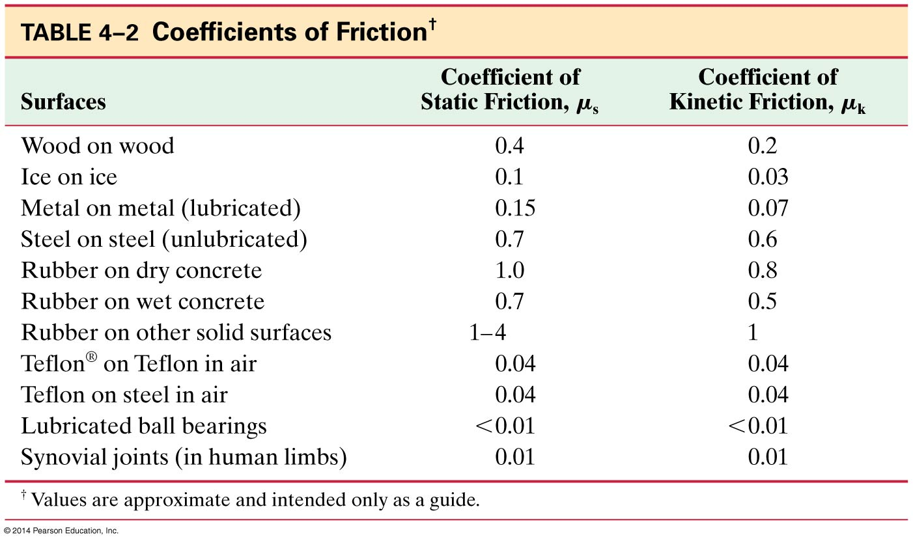
4-8 Problems Involving Friction, Inclines
This table lists the measured values of some coefficients of friction. Note that the coefficient depends on both surfaces.

Slide 20
4-8 Problems Involving Friction, Inclines
Static friction is the frictional force between two surfaces that are not moving along each other. Static friction keeps objects on inclines from sliding, and keeps objects from moving when a force is first applied.

Slide 21
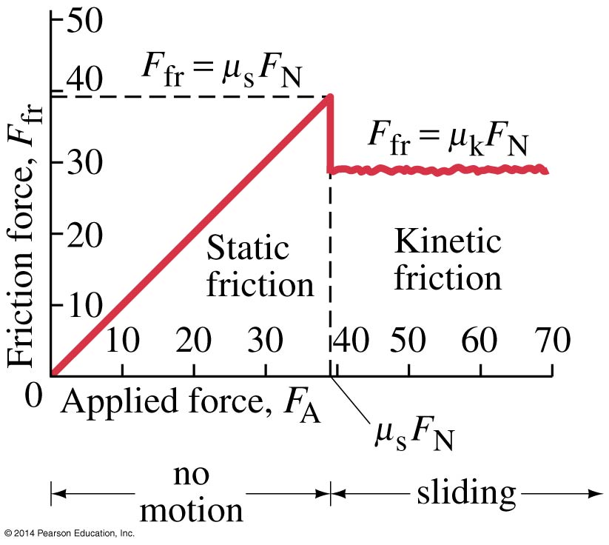
4-8 Problems Involving Friction, Inclines
The static frictional force increases as the applied force increases, until it reaches its maximum. Then the object starts to move, and the kinetic frictional force takes over.

Slide 22
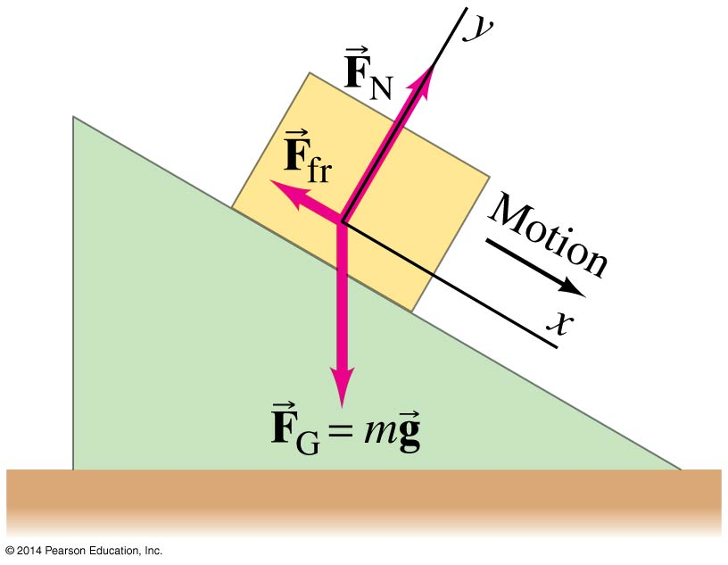
4-8 Problems Involving Friction, Inclines
An object sliding down an incline has three forces acting on it: the normal force, gravity, and the frictional force.
The normal force is always perpendicular to the surface.
The friction force is parallel to it.
The gravitational force points down.
If the object is at rest, the forces are the same except that we use the static frictional force, and the sum of the forces is zero.

Slide 23
Summary of Chapter 4
Newton’s first law: If the net force on an object is zero, it will remain either at rest or moving in a straight line at constant speed.
Newton’s second law:
Newton’s third law:
Weight is the gravitational force on an object.
The frictional force can be written F_{fr} = μ_{k}F_{N} (kinetic friction) or F_{fr} ≤ μ_{s}F_{N} (static friction)
(4-1)
(4-2)

