Slide 1
PRE LAB due Monday
Open Ended Experiment

Slide 4
DAY 11
FOCUS: How can we solve relative velocity problems?
PRELAB REPORTS ARE DUE NOW.

Slide 5
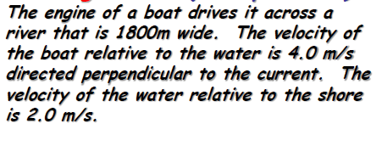
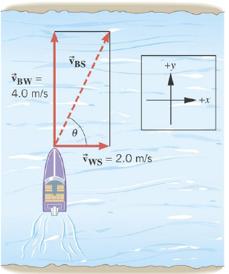
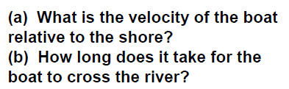

Slide 7
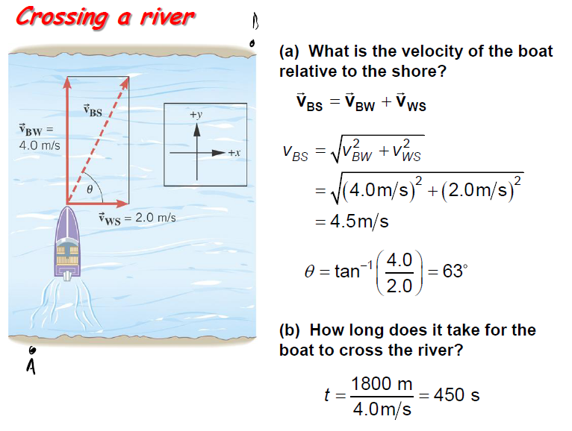

Slide 8
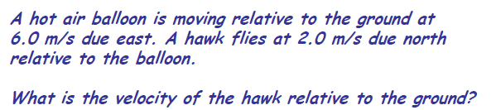
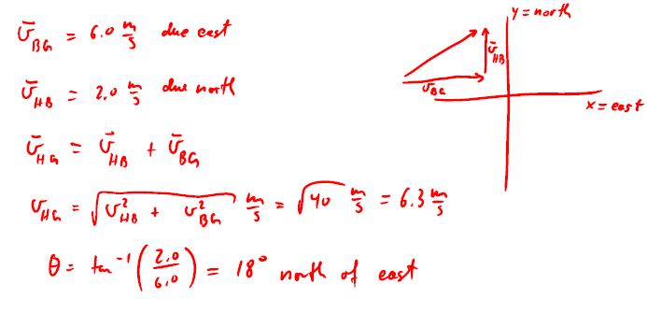

Slide 9

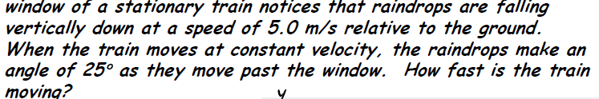
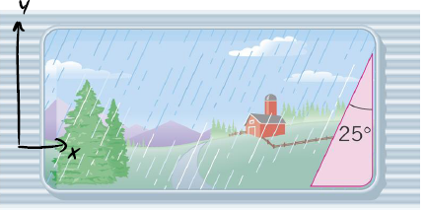
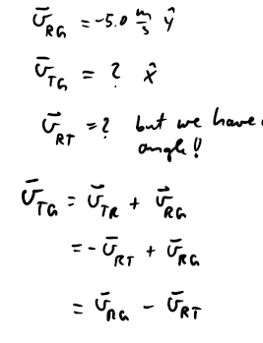
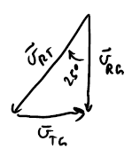
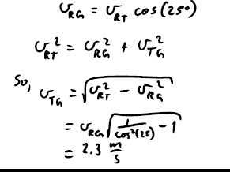

Slide 10
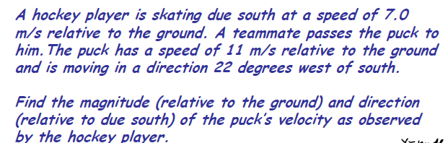
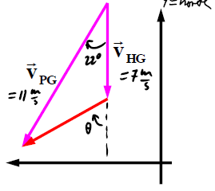




Slide 11
VIDEO
https://science360.gov/obj/video/0404b1b8-70ba-486d-90b4-93fcefc89377/science-nfl-football-kinematics

Slide 12
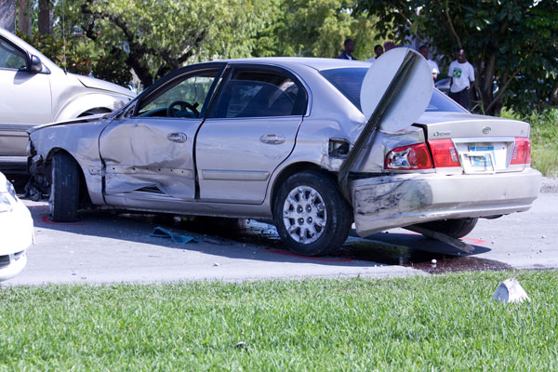
How Graphs Show Velocity and Speed
What is happening in this
graph?
Motionless
Object
CONSTANT
ZERO
SLOPE

Slide 13

How Graphs Show Velocity and Speed
What is happening in this
graph?
Moving with
CONSTANT
positive velocity
CONSTANT
POSITIVE
SLOPE

Slide 14
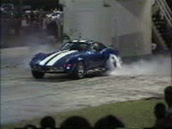
How Graphs Show Velocity and Speed
What is happening in this
graph?
Moving with
INCREASING
velocity
INCREASING
SLOPE

Slide 15
Using v-t Graphs
What can we DO
with a v-t graph?
Find average
velocity
Find distance
traveled
Find displacement
Area under the graph
Area on TOP and BOTTOM
both considered POSITIVE
Area under the graph
Area on TOP = POSITIVE
Area on BOTTOM = NEGATIVE
How do you use the v-t graph to find DISTANCE TRAVELED?
How do you use the v-t graph to find DISPLACEMENT?
How do you use the v-t graph to find
AVERAGE VELOCITY?

Slide 16
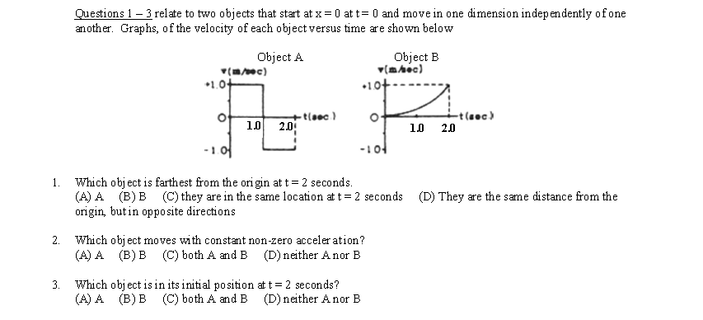
Describe MOTION
1. Constant Speed
2. Constant Acceleration

Slide 17
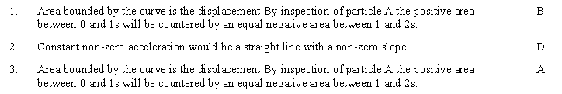
SOLUTION

Slide 18
The 3 Kinematic equations
There are 3 major kinematic equations than can be used to describe the motion in DETAIL. All are used when the acceleration is CONSTANT.

Slide 19
Defining the important variables
Kinematics is a way of describing the motion of objects without describing the causes. You can describe an object’s motion:
In words Mathematically Pictorially Graphically
No matter HOW we describe the motion, there are several KEY VARIABLES that we use.
Symbol | Variable | Units
t | Time | s
a | Acceleration | m/s/s
x or y | Displacement | m
v_{o} | Initial velocity | m/s
v | Final velocity | m/s
g or a_{g} | Acceleration due to gravity | m/s/s

Slide 20
Kinematic #1

Slide 21
Kinematic #1
Example: A boat moves slowly out of a marina (so as to not leave a wake) with a speed of 1.50 m/s. As soon as it passes the breakwater, leaving the marina, it throttles up and accelerates at 2.40 m/s/s.
a) How fast is the boat moving after accelerating for 5 seconds?
What do I know? | What do I want?
v_{o}= 1.50 m/s | v = ?
a = 2.40 m/s/s
t = 5 s
13.5 m/s

Slide 22
Kinematic #2
b) How far did the boat travel during that time?
37.5 m

Slide 23
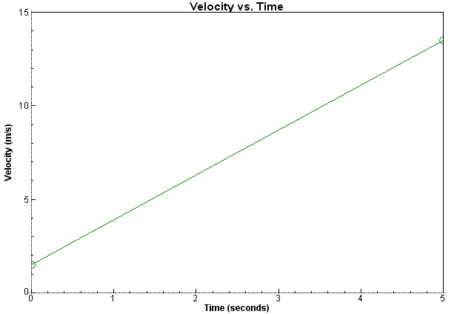
Does all this make sense?
13.5 m/s
1.5 m/s
Total displacement = 7.50 + 30 = 37.5 m = Total AREA under the line.

Slide 24
Interesting to Note
A = HB
Most of the time, x_{o}=0, but if it is not don’t forget to ADD in the initial position of the object.
A=1/2HB

Slide 25
Kinematic #3
Example: You are driving through town at 12 m/s when suddenly a ball rolls
out in front of your car. You apply the brakes and begin decelerating at
3.5 m/s/s.
How far do you travel before coming to a complete stop?
What do I know? | What do I want?
v_{o}= 12 m/s | x = ?
a = -3.5 m/s/s
V = 0 m/s
20.57 m

Slide 26
Common Problems Students Have
I don’t know which equation to choose!!!
Equation | Missing Variable
 | x
 | v
 | t

Slide 27
Kinematics for the VERTICAL Direction
All 3 kinematics can be used to analyze one dimensional motion in either the X direction OR the y direction.

Slide 28
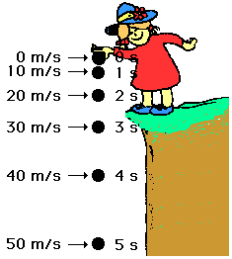
“g” or a_{g} – The Acceleration due to gravity
The acceleration due to gravity is a special constant that exists in a VACUUM, meaning without air resistance. If an object is in FREE FALL, gravity will CHANGE an objects velocity by 9.8 m/s every second.
The acceleration due to gravity:
ALWAYS ACTS DOWNWARD
IS ALWAYS CONSTANT near the surface of Earth

Slide 29
Examples
A stone is dropped at rest from the top of a cliff. It is observed to hit the ground 5.78 s later. How high is the cliff?
What do I know? | What do I want?
v_{oy}= 0 m/s | y = ?
g = -9.8 m/s²
y_{o}=0 m
t = 5.78 s
Which variable is NOT given and
NOT asked for?
Final Velocity!
-163.7 m
H =163.7m

Slide 30
Examples
A pitcher throws a fastball with a velocity of 43.5 m/s. It is determined that during the windup and delivery the ball covers a displacement of 2.5 meters. This is from the point behind the body when the ball is at rest to the point of release. Calculate the acceleration during his throwing motion.
What do I know? | What do I want?
v_{o}= 0 m/s | a = ?
x = 2.5 m
v = 43.5 m/s
Which variable is NOT given and
NOT asked for?
TIME
378.5 m/s/s

Slide 31
Examples
How long does it take a car at rest to cross a 35.0 m intersection after the light turns green, if the acceleration of the car is a constant 2.00 m/s/s?
What do I know? | What do I want?
v_{o}= 0 m/s | t = ?
x = 35 m
a = 2.00 m/s/s
Which variable is NOT given and
NOT asked for?
Final Velocity
5.92 s

Slide 32
Examples
A car accelerates from 12.5 m/s to 25 m/s in 6.0 seconds. What was the acceleration?
What do I know? | What do I want?
v_{o}= 12.5 m/s | a = ?
v = 25 m/s
t = 6s
Which variable is NOT given and
NOT asked for?
DISPLACEMENT
2.08 m/s/s

